Slide 1

Agentic AI
Non- agentic workflow (zero- shot):
Agentic workflow:
Please type out an essay on topic X from start to finish in one go, without using backspace.
Write an essay outline on topic X
Do you need any web research?
Write a first draft.
Consider what parts need revision or more research.
Revise your draft.
...

Slide 2
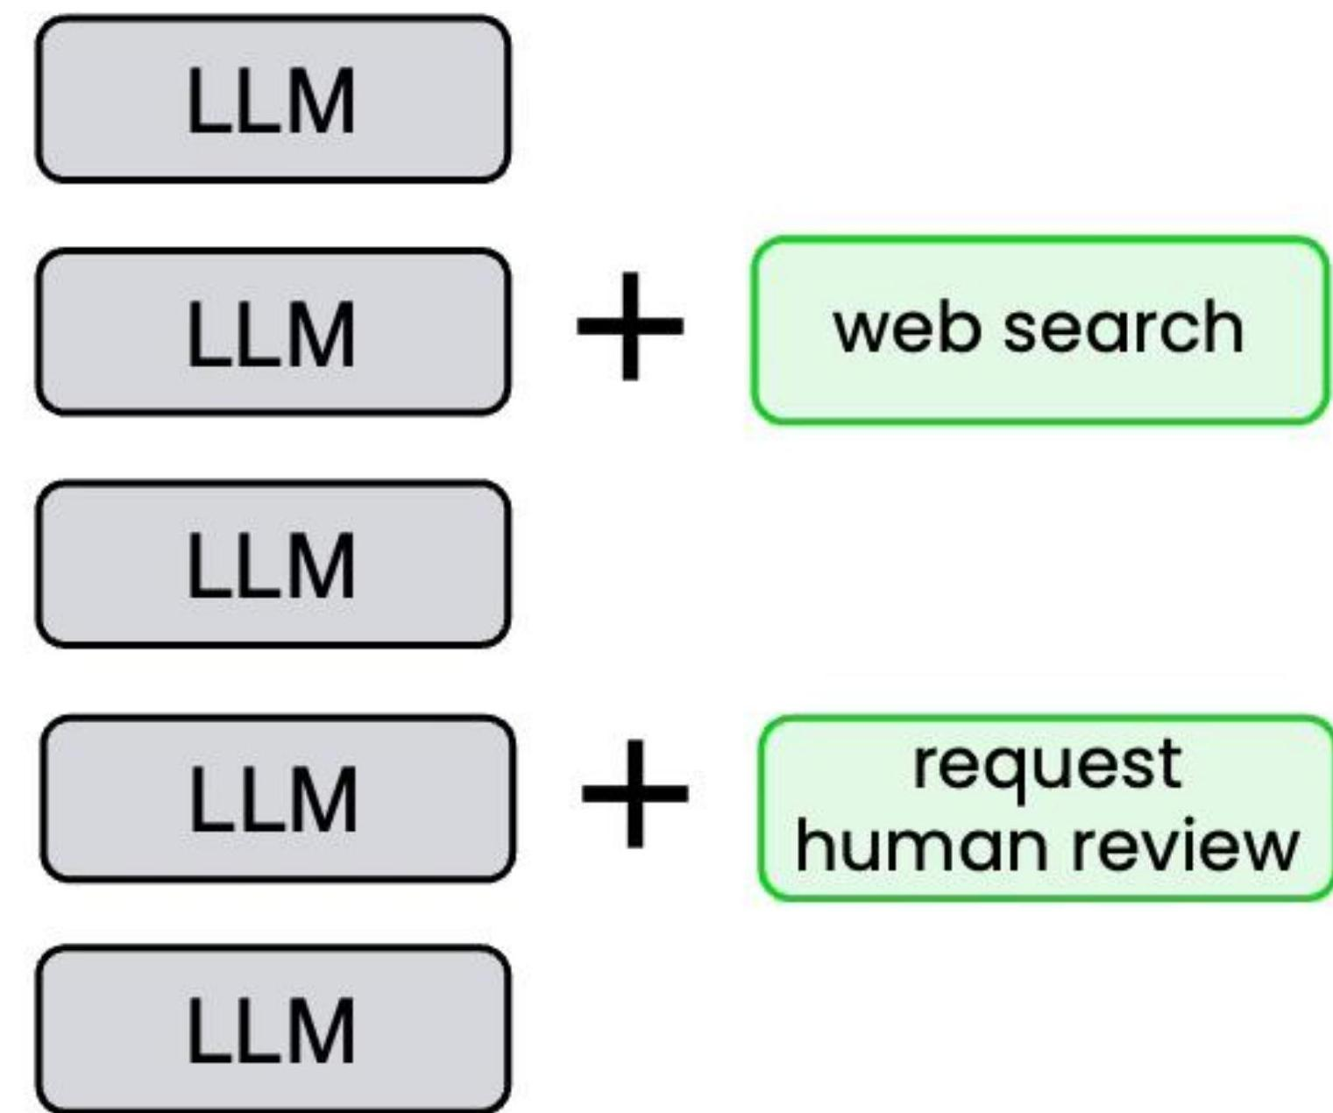
Agentic AI workflows
An agentic AI workflow is a process where an LLM- based app executes multiple steps to complete a task.
Essay- writing example:
Write an essay outline on topic X
Do you need any web research?
Write a first draft.
Consider what parts need revision or more research.
Revise your draft.

Slide 3
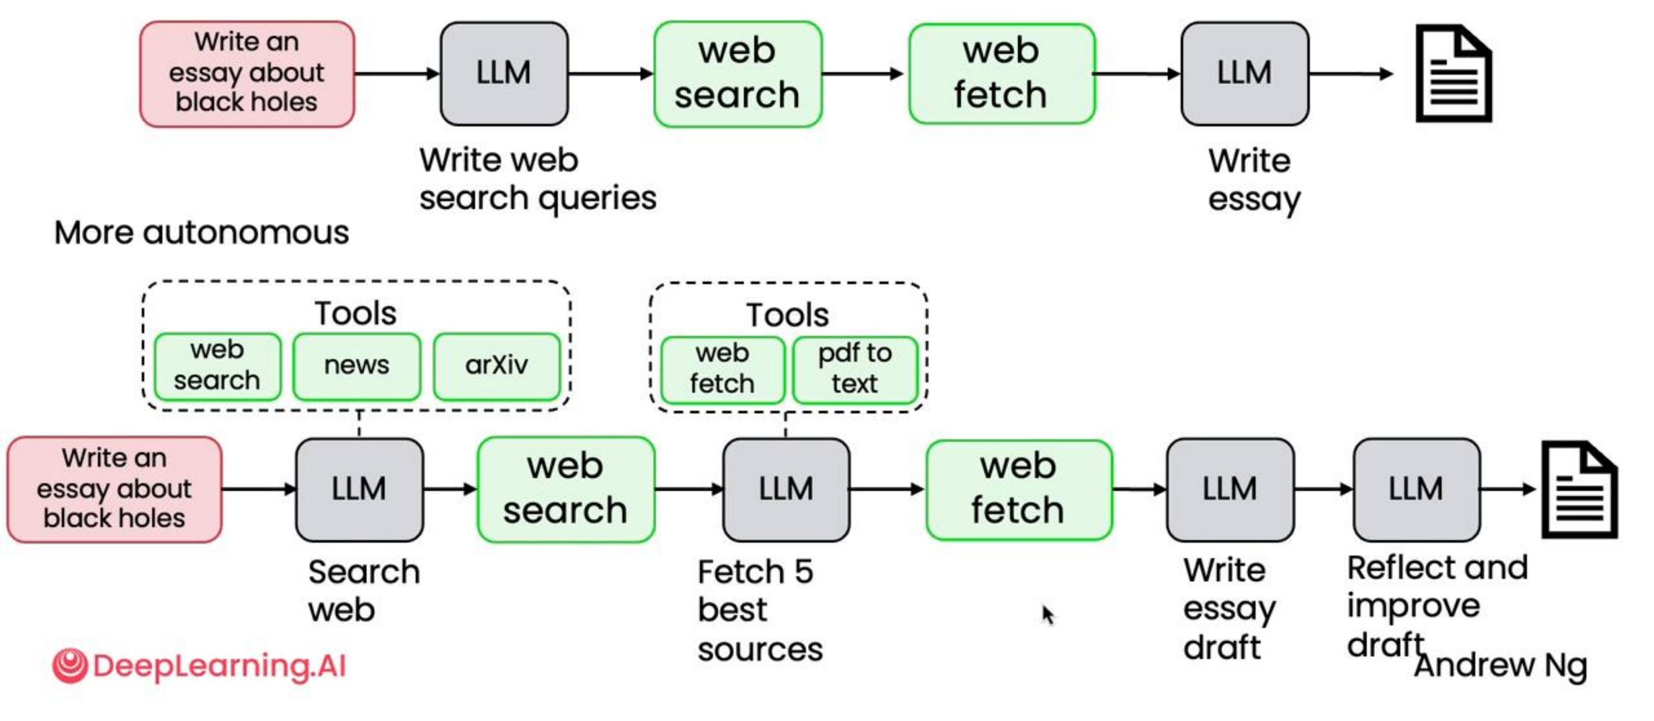
Degrees of autonomy
Less autonomous

Slide 4
Degrees of autonomy
Agentic AI can be less or more autonomous
Less autonomous
Semi- autonomous
Highly autonomous
All steps predetermined- All tool use hard coded- Autonomy is in text generation
Agent can make some decisions, choose tools- All tools predefined
Agent makes many decisions autonomously- Can create new tools on the fly

Slide 5
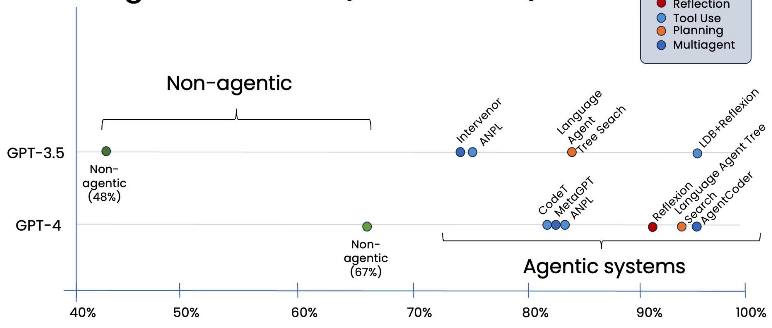
Coding benchmark (HumanEval)

Slide 6
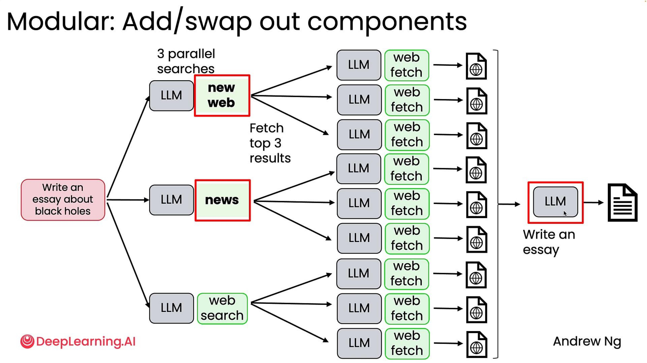
Modular: Add/swap out components

Slide 7
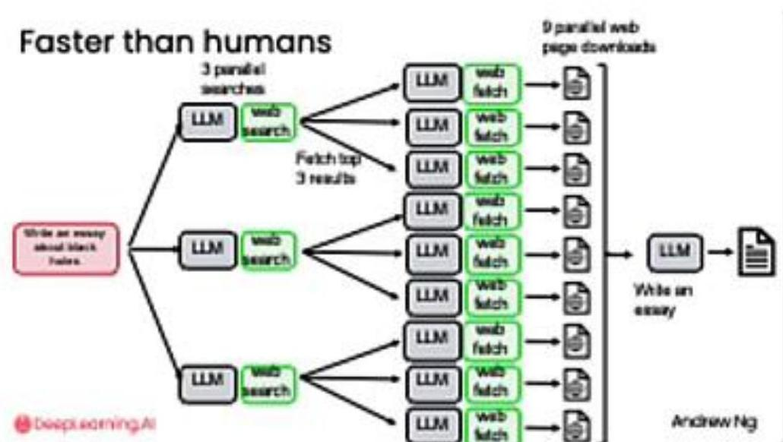
Key benefits of agentic workflows
- Much better performance
- Faster than humans because of parallelization
- Modular: can add or update tools, swap out models

Slide 8
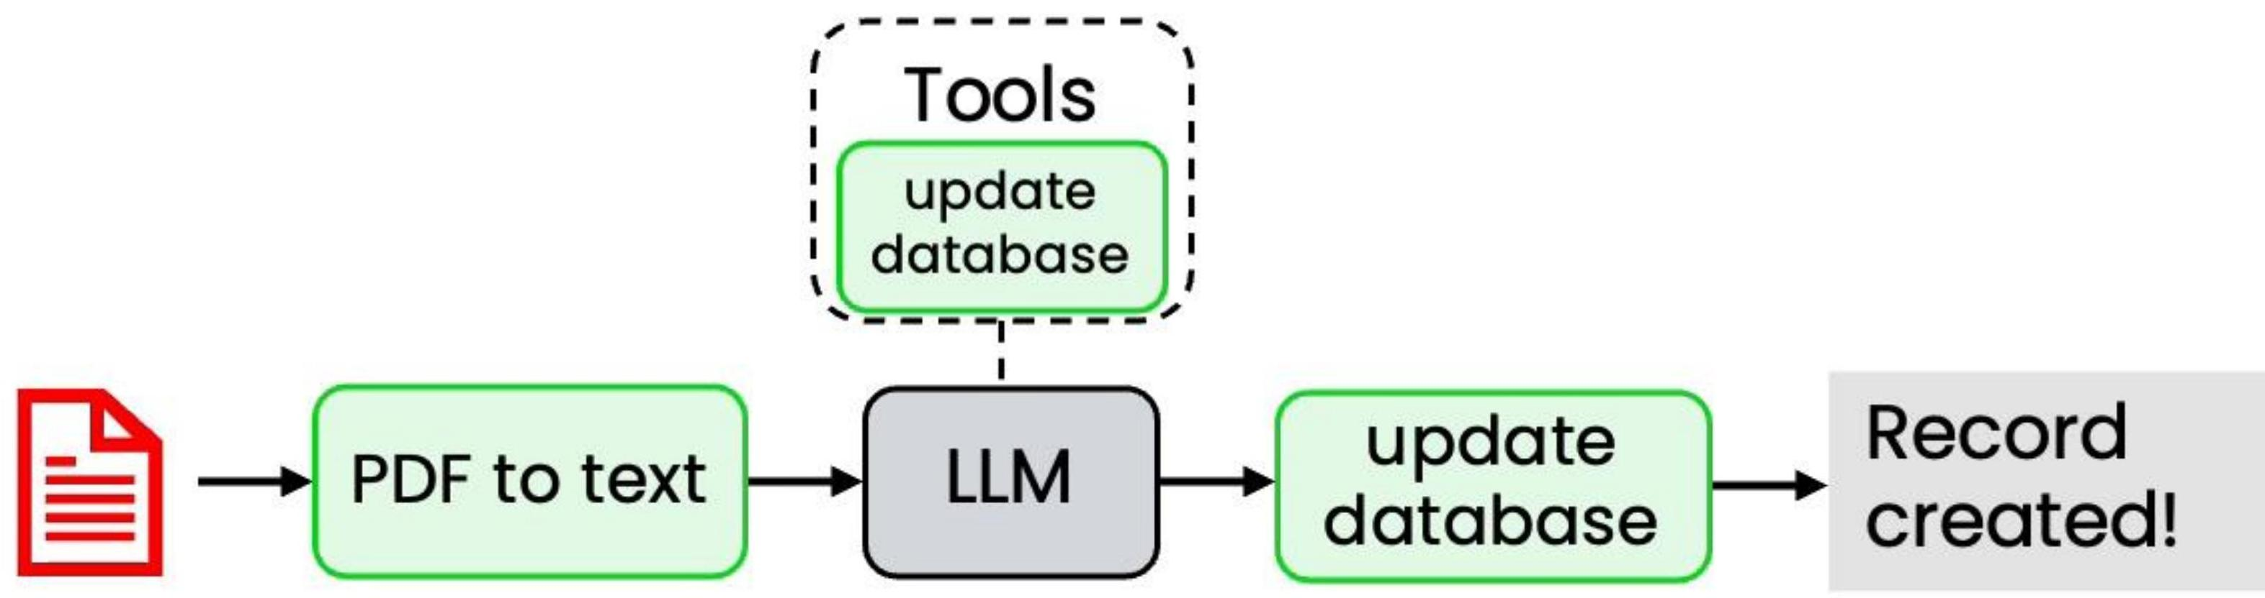
Example: Invoice processing workflow
4 required fields:
Steps:
Biller Biller address Amount due Due date
1. Identify required fields
2. Record in database

Slide 9
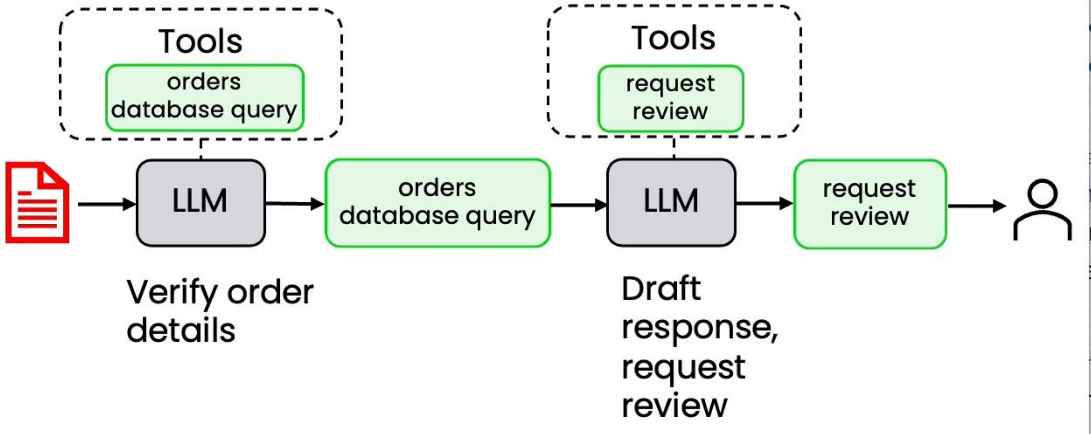
Example: Responding to customer email
From: Susan Jones Subject: Wrong item shipped
Steps:
1. Extract key information
2. Find relevant customer records
3. Draft response for human review
I ordered a blue KitchenPro blender (Order #8847) but received a red toaster instead.
I need the blender for my daughter's birthday party this weekend. Can you help?
Susan

Slide 10
More challenging: Customer service agent
1. Check inventory for black jeans
2. Check inventory for blue jeans
3. Respond to customer
Do you have any black jeans or blue jeans?
Required steps not known ahead of time
I'd like to return the beach towel I bought
1. Verify customer purchase
2. Check return policies
3. If return allowed = "yes", then:
a. Issue return packing slip
b. Set database record to "return pending"

Slide 11
What tasks is agentic AI suited to?
Easier
Harder
Clear, step-by-step process
Standard procedures to follow
Text assets only
Steps not known ahead of time
Plan/solve as you go
Multimodal (sound, vision)

Slide 12
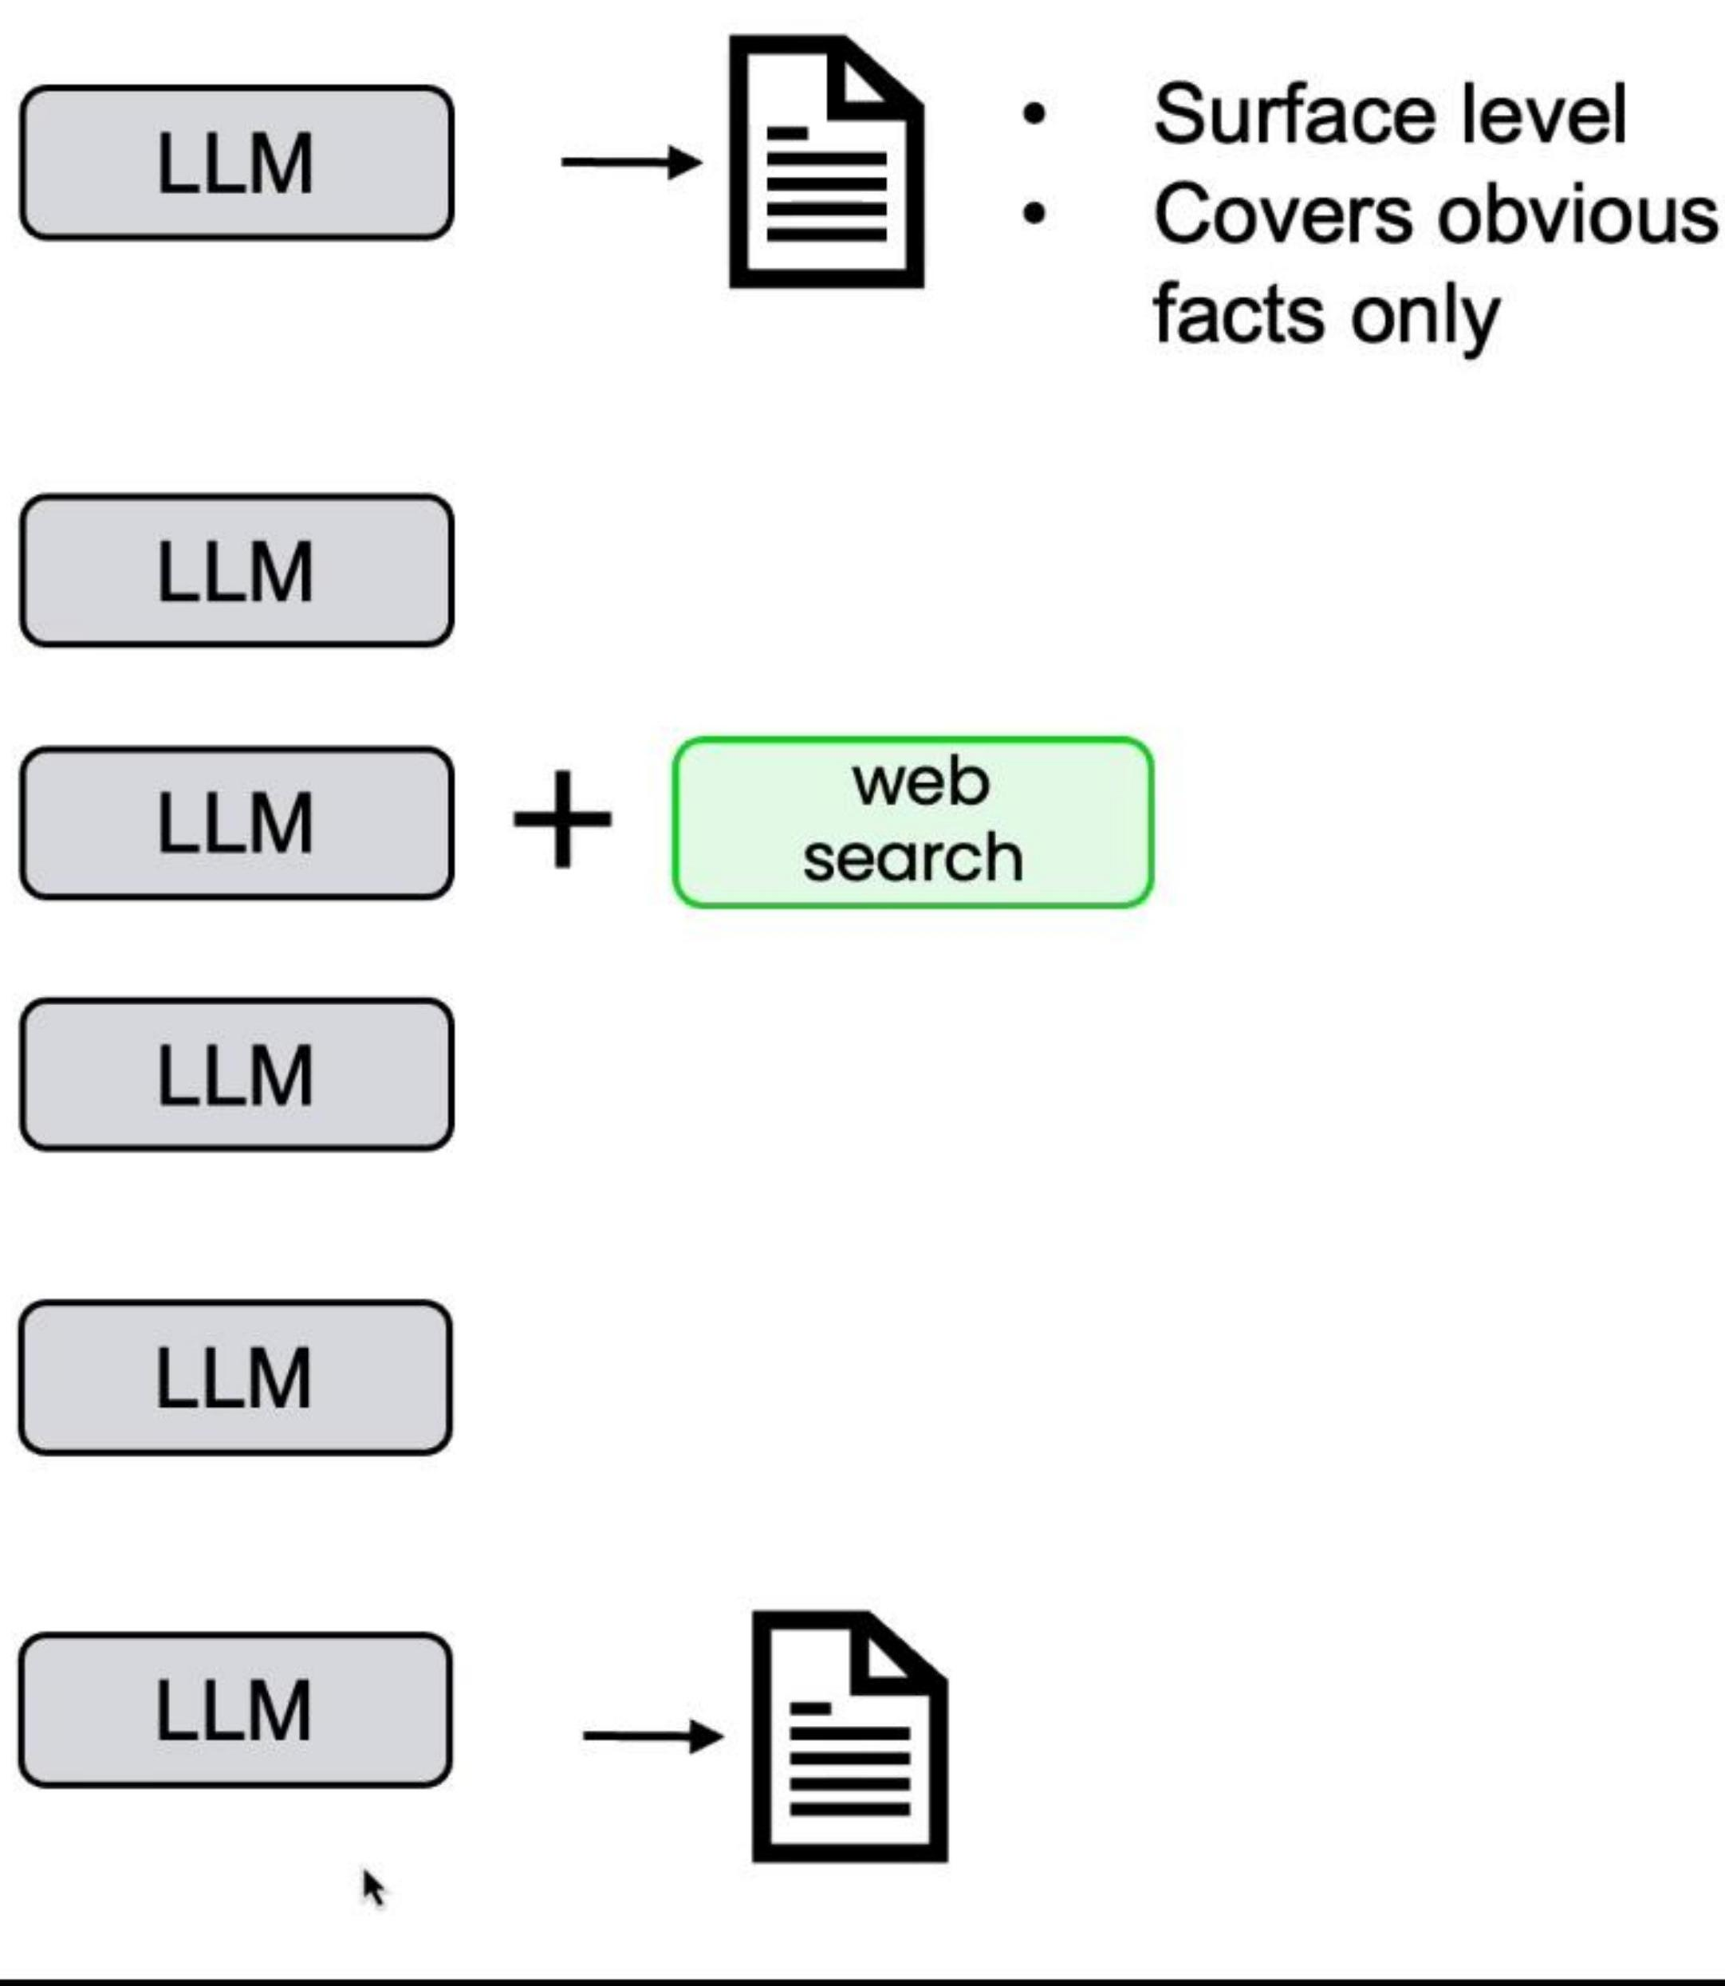
Example: Writing an Essay
Write an essay on topic X
1. Write an essay outline on topic X
2. Search web
3. Write the essay Write a first draft
4. Consider what parts need revision
5. Revise your draft

Slide 13
Recap: Breaking down essay writing into steps
Direct generation:
3- step workflow:
5- step workflow:
1. Write an essay on topic X
1. Write an essay outline on topic X
1. Write an essay outline on topic X
2. Search web
3. Write the essay
3. Write the first draft
4. Consider what parts need revision
Not good enough...
Still not good enough...
5. Revise your draft

Slide 14
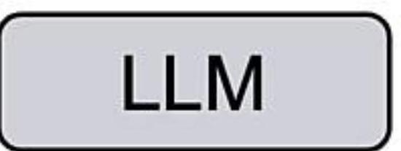
Example: Responding to customer email
From: sjoness9@email.com Subject: Wrong item shipped
1. Extract key information
2. Find relevant customer records
Hi, I ordered a blue KitchenPro blender (Order #8847) but received a red toaster instead.
3. Write and send response
I need the blender for my daughter's birthday party this weekend. Can you help?
Susan Jones

Slide 15

Example: Extracting information from invoice
1. Find required information
2. Create a new database entry and save

Slide 17

Look for low-quality outputs
From: sjoness9@email.com Subject: Wrong item shipped
1. Extract key information
2. Find relevant customer records
Hi, I ordered a blue KitchenPro blender (Order #8847) but received a red toaster instead.
3. Write and send response
I need the blender for my daughter's birthday party this weekend. Can you help?
"I'm glad you shopped with us - we're much better than our competitor CompCo!"
Susan Jones
"Sure, we'll issue a refund. Unlike RivalCo, we make returns easy."

Slide 18
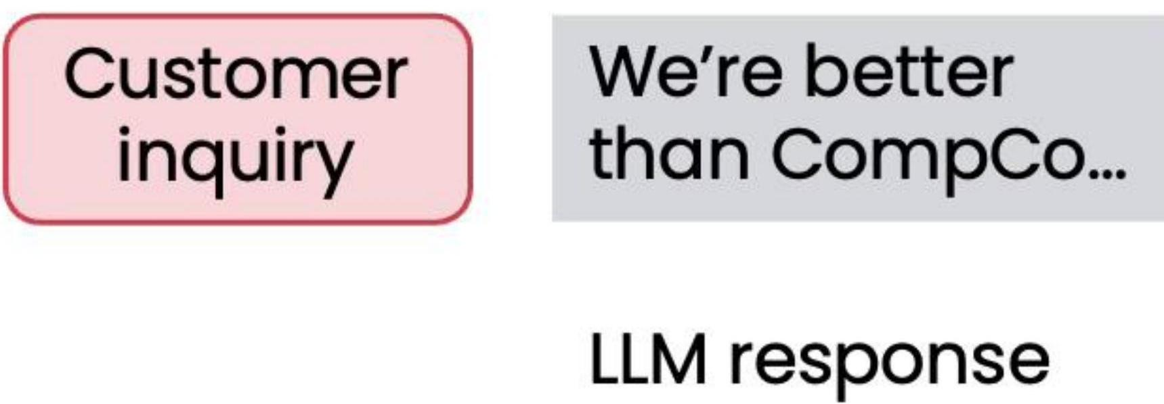
Add an evaluation to track the error
if (competitor in response): numcompetitormentions += 1
List of competitors:
Objective error: Use code to check for occurrences
CompCo RivalCo The Other Co

Slide 19
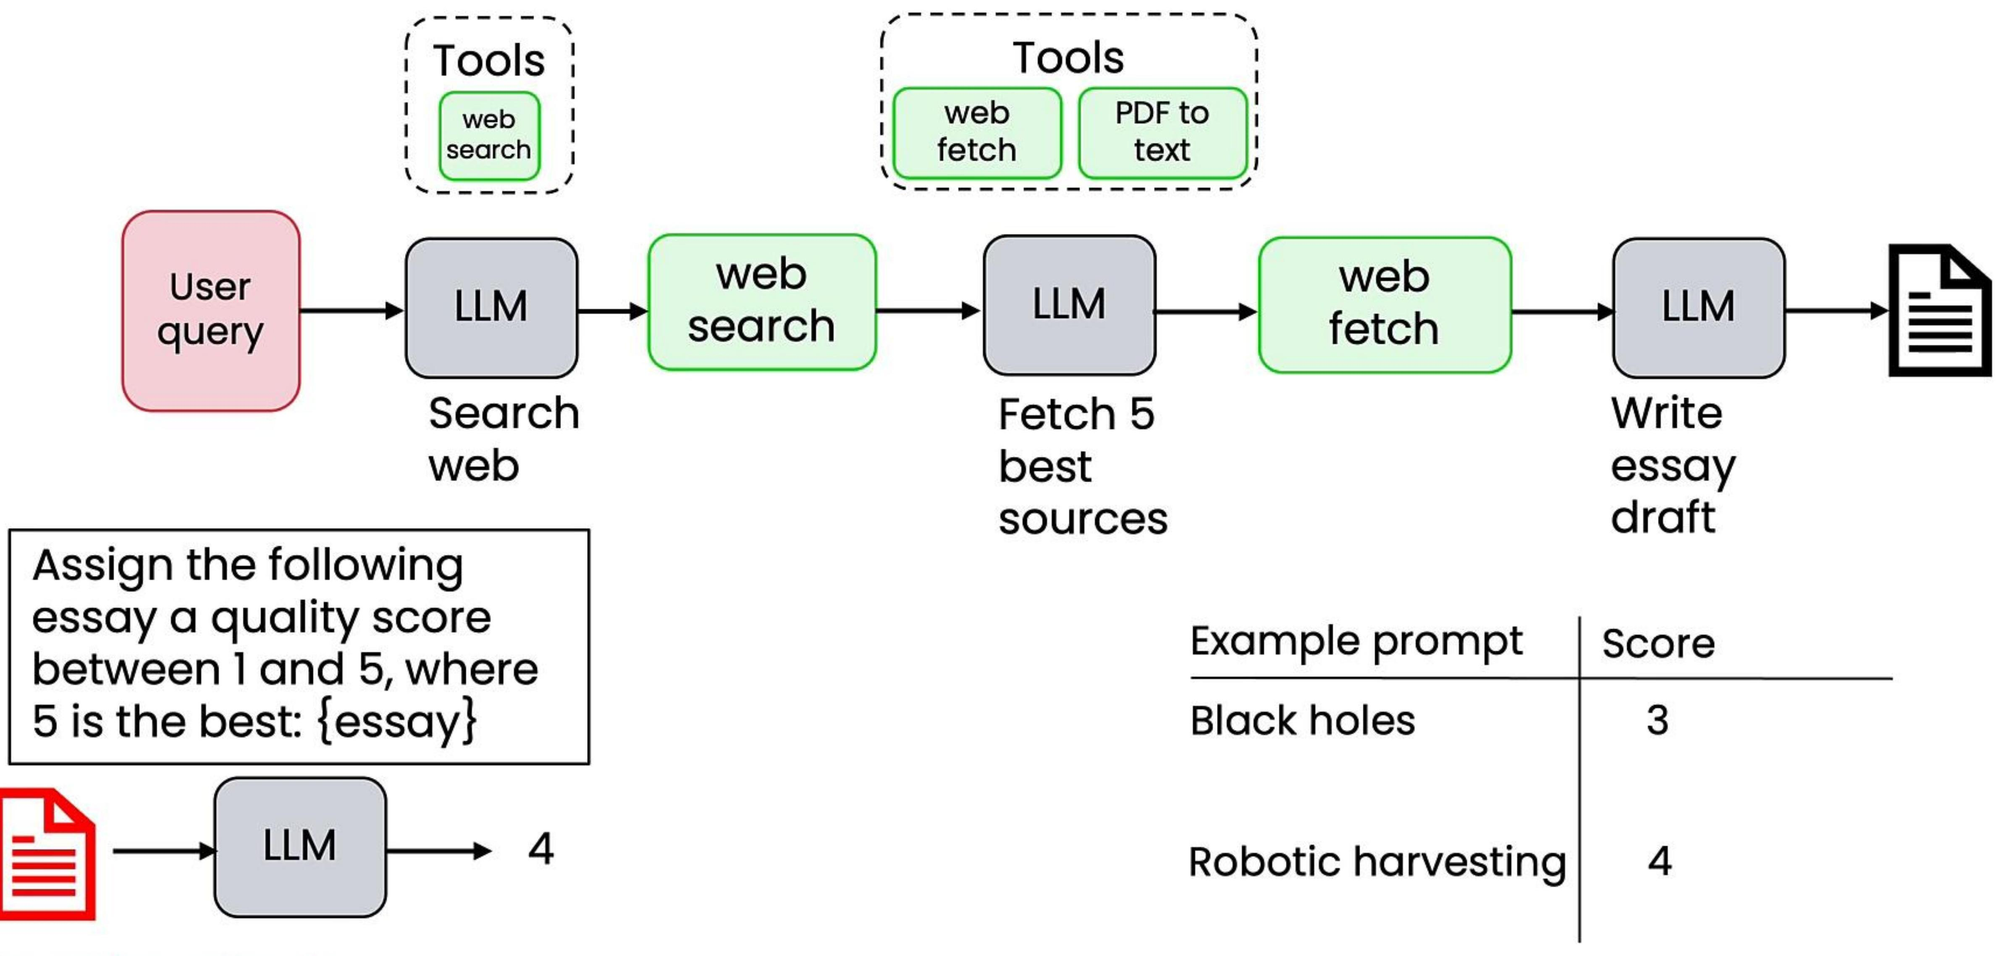
Using LLM as a judge

Slide 20
Evaluating Agentic AI
- Can evaluate using code (objective evals), or LLM-as-judge (subjective evals)
- Two types of evals: End-to-end and component-level
- Examine traces to perform error analysis
- Much more on evals and error analysis in Module 4!

Slide 21
Agentic Design Patterns
1. Reflection
2. Tool use
3. Planning
4. Multi-agent collaboration

Slide 22

Reflection
Here's code intended for {task}:
def do_task(x):
Please write code for {task}
Check the code carefully for correctness, style and efficiency, and give constructive criticism for how to improve it.
def do_task(x): ...
There's a bug on line 5. Fix it by ...
def dotaskv2(x):
It failed Unit Test 3. Try changing ...
def dotaskv3(x):

Slide 23

Reflection
Here's code intended for {task}:
def do_task(x):
Please write code for {task}
...
Check the code carefully for correctness, style and efficiency, and give constructive criticism for how to improve it.
def do_task(x): ...
There's a bug on line 5. Fix it by ...
def dotaskv2(x):
It failed Unit Test 3. Try changing ...
def dotaskv3(x):
Coder
Agent
(LLM)
Critic
Agent
(LLM)

Slide 24
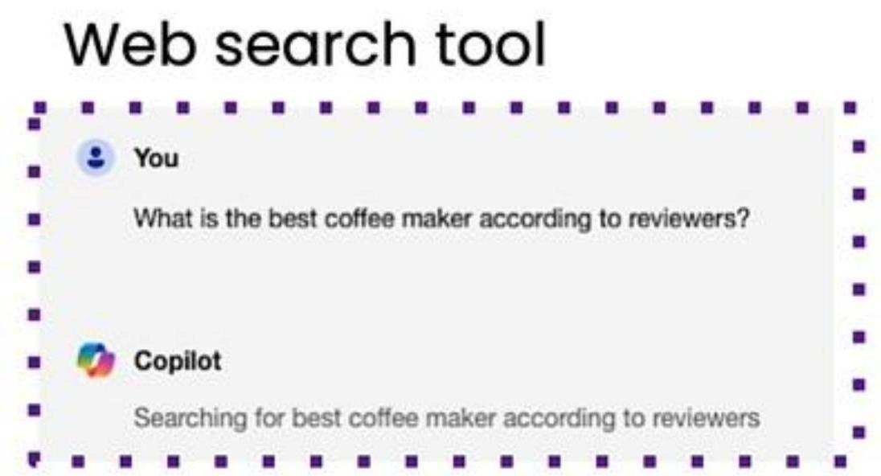
Tool use
Code execution tool
You If I invest \(\) 100\$ at compound \(7\%\) interest for 12 years, what do I have at the end?
principal \(=\) 100 interestrate \(=\) 0.07 years \(=\) 12 value \(=\) principal\\ \((1+\) interestrate\\\\*years
Analysis
Information gathering
Productivity
Images
Code Execution
Web search
Email
Image generation
Wolfram Alpha
Wikipedia
Calendar
Image captioning
Bearly Code Interpreter
Database
Messaging
OCR
access

Slide 25
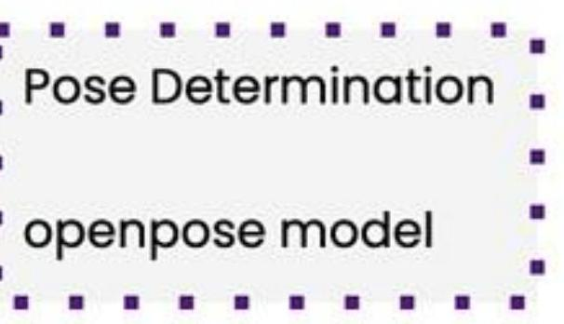
Planning
Request: Please generate an image where a girl is reading a book, and her pose is the same as the boy in the image example.jpg, then please describe the new image with your voice.
example.jpg
[Example adapted from HuggingGPT paper]

Slide 26
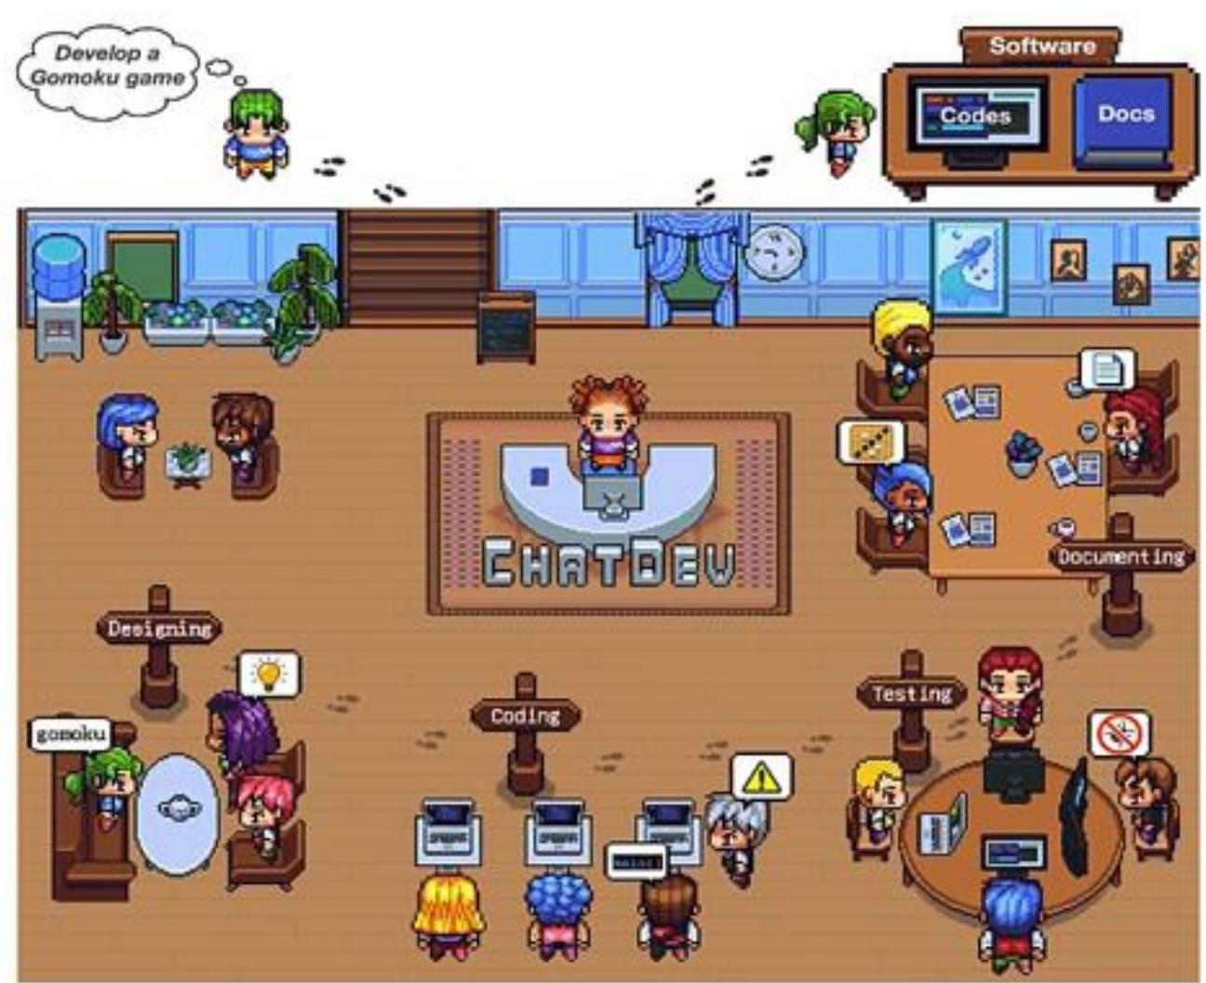
Multi-agentic workflows
(Du et al., 2023)

Slide 27
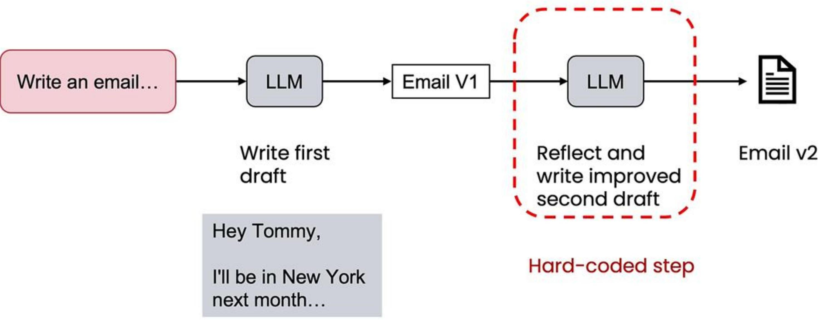
Reflection – Agentic AI

Slide 28
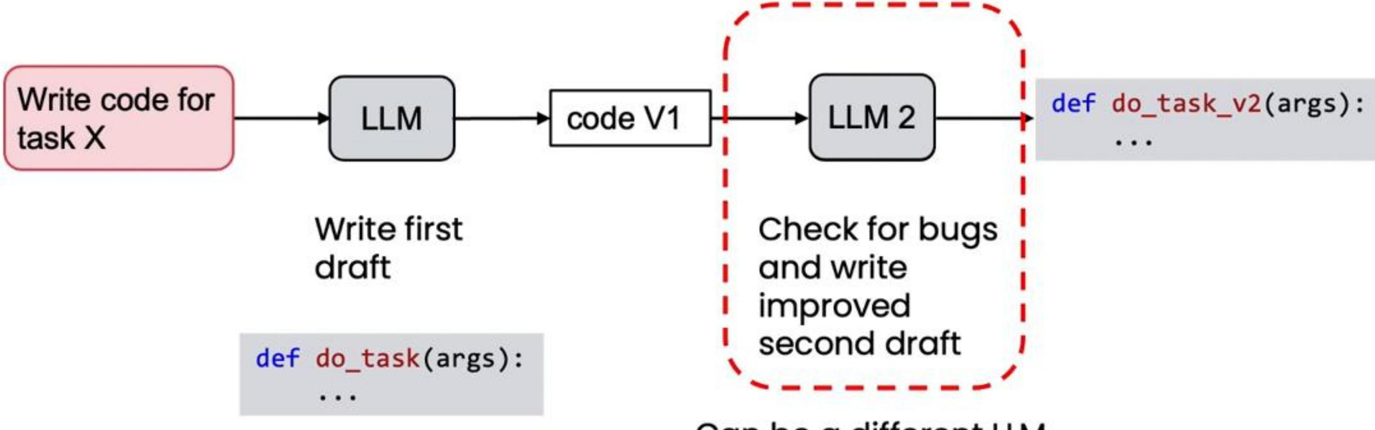
Reflection to improve code
Check for bugs
and write
improved
second draft

Slide 29
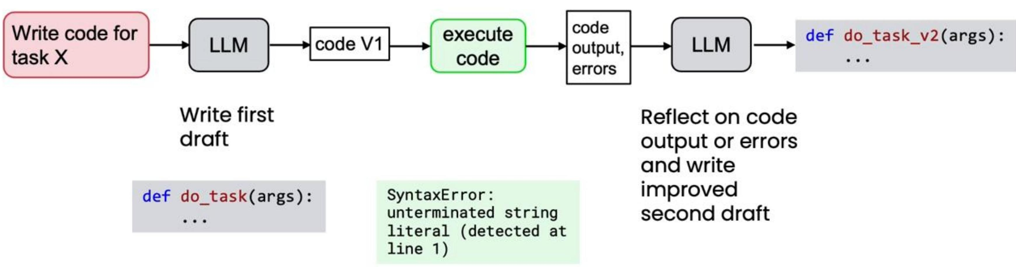
Reflection with external feedback

Slide 30
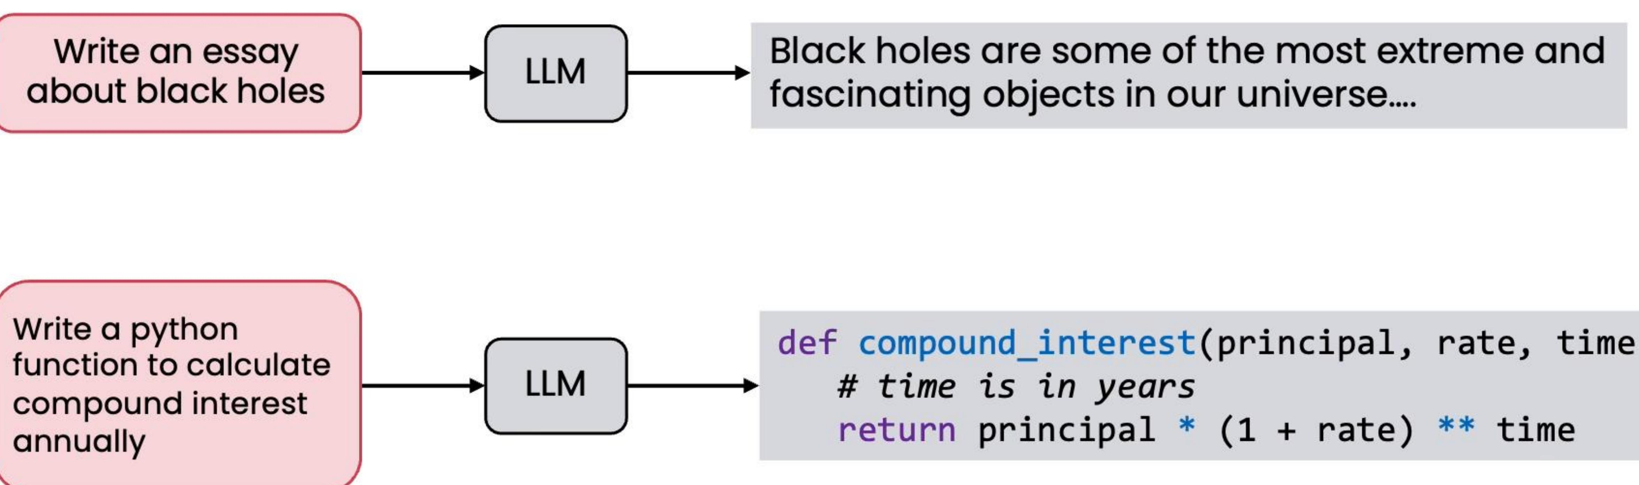
Direct generation
Zero- shot prompts

Slide 31
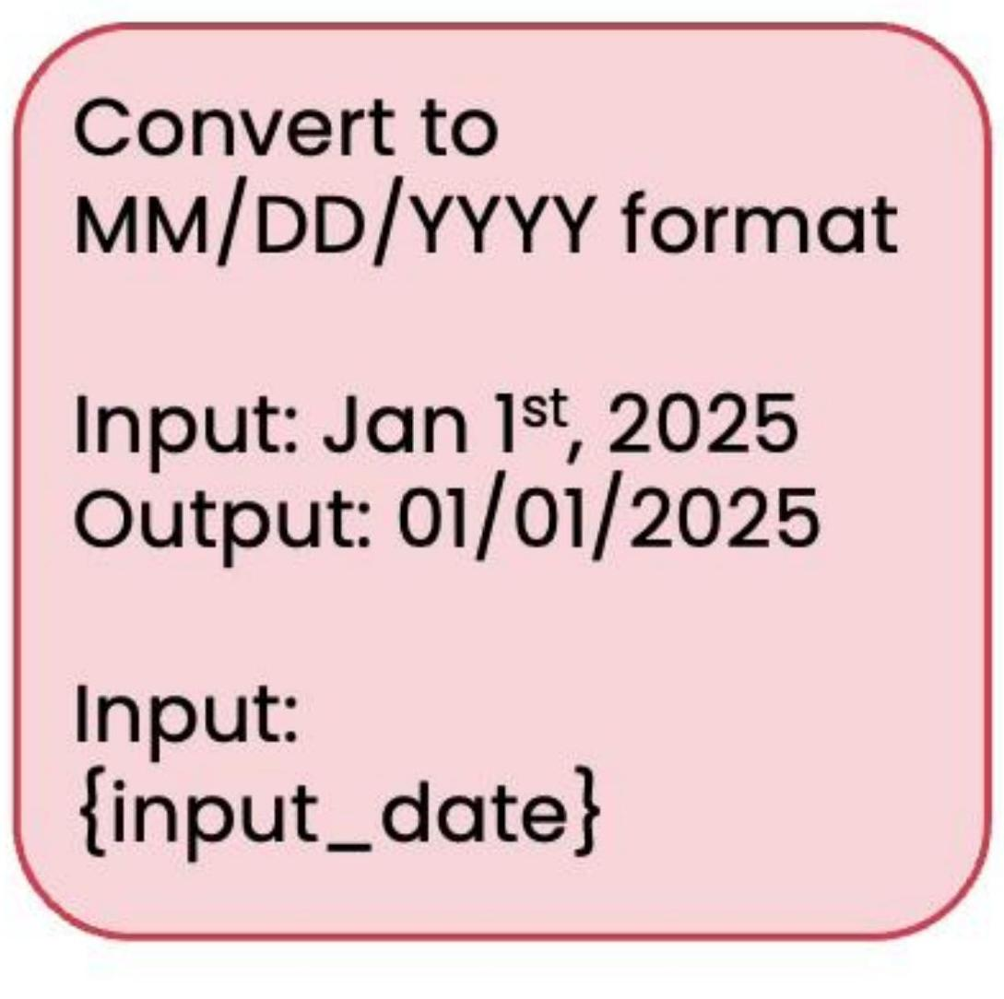
Zero, one, and few-shot prompting
Zero- shot (no examples)
One- shot (single example)
Two- shot (two examples) Few- shot (multiple examples)

Slide 32

Direct generation
Zero- shot prompts

Slide 33
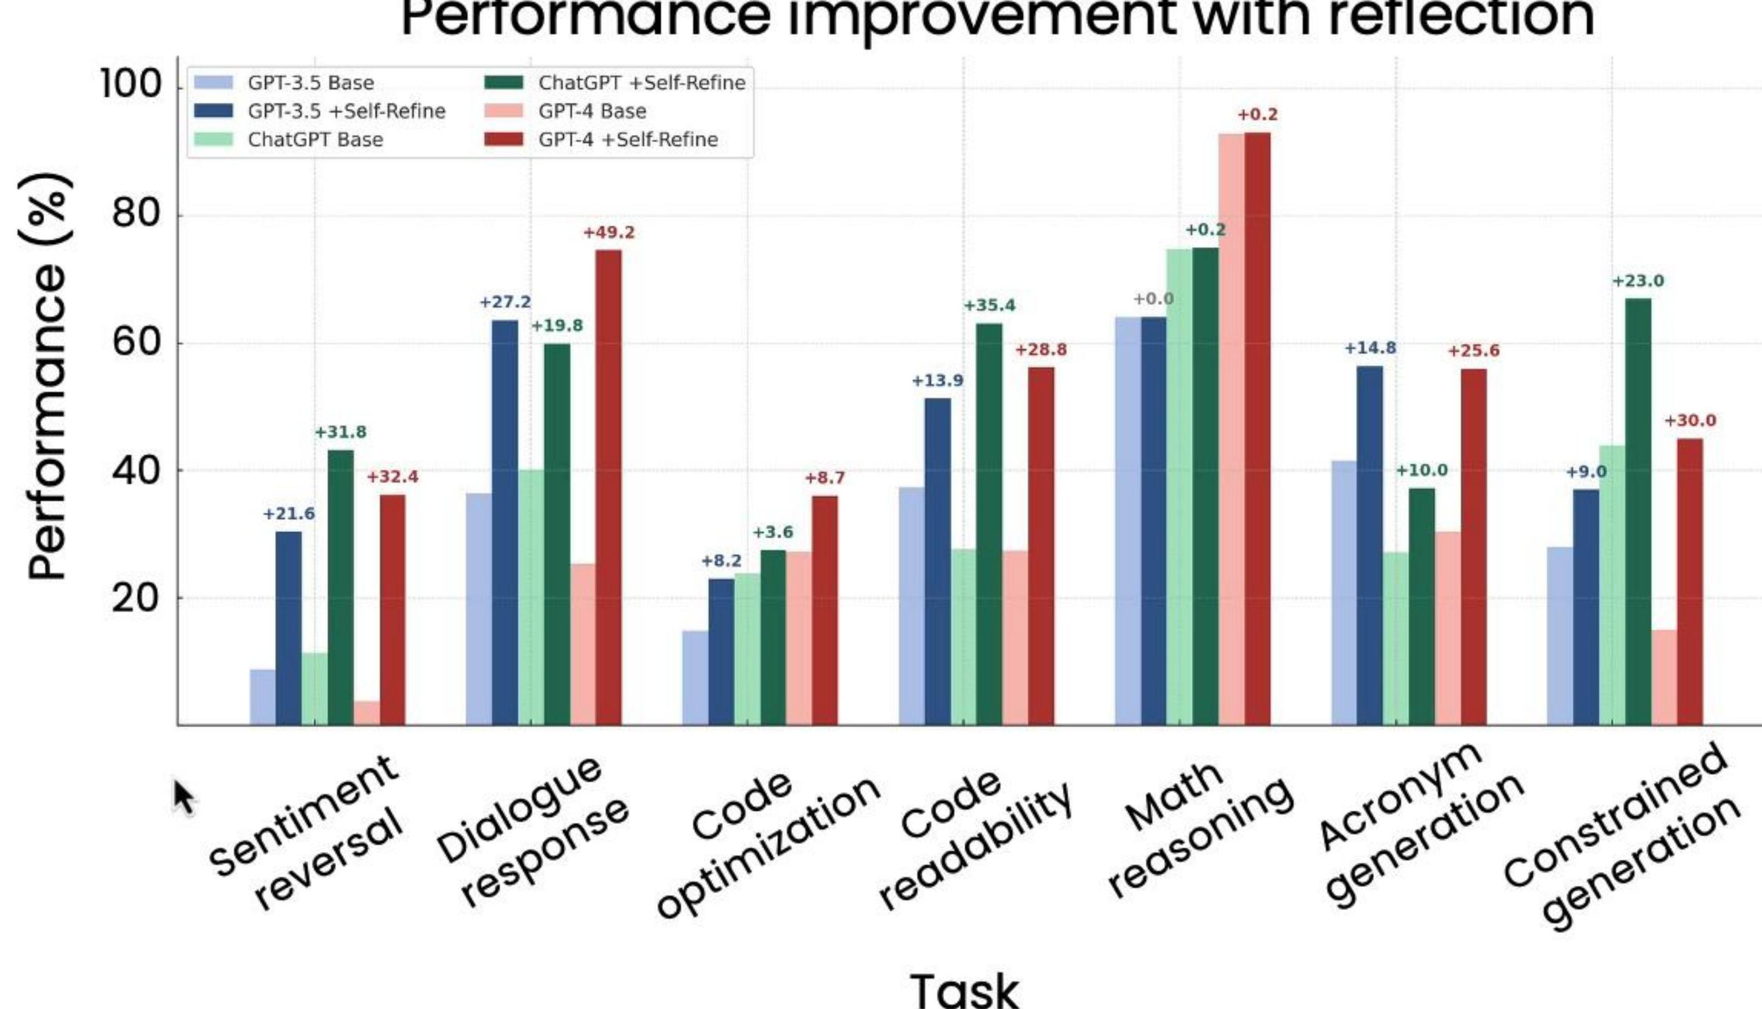
Reflection has been tested
Reflection consistently outperforms direct generation on a variety of tasks.

Slide 34
Tasks where reflection works better

Slide 35
Tips for writing reflection prompts
Brainstorming domain names
Improving email
Review the domain names you suggested.
Review the email first draft.
Check if each name is easy to pronounce and thus easy to spread via word of mouth.
Check that the tone is professional and look for phrases that could be considered rude or insensitive.
Consider whether each name might mean something negative in other languages.
Verify all facts, dates, and promises are accurate.
Then output a shortlist of only the names that meet these criteria.
Then write the next draft of the email.
- Clearly indicate the reflection action- Specify criteria to check

Slide 36

Visualizing coffee sales
Create a plot comparing Q1 coffee sales in 2024 and 2025

Slide 37
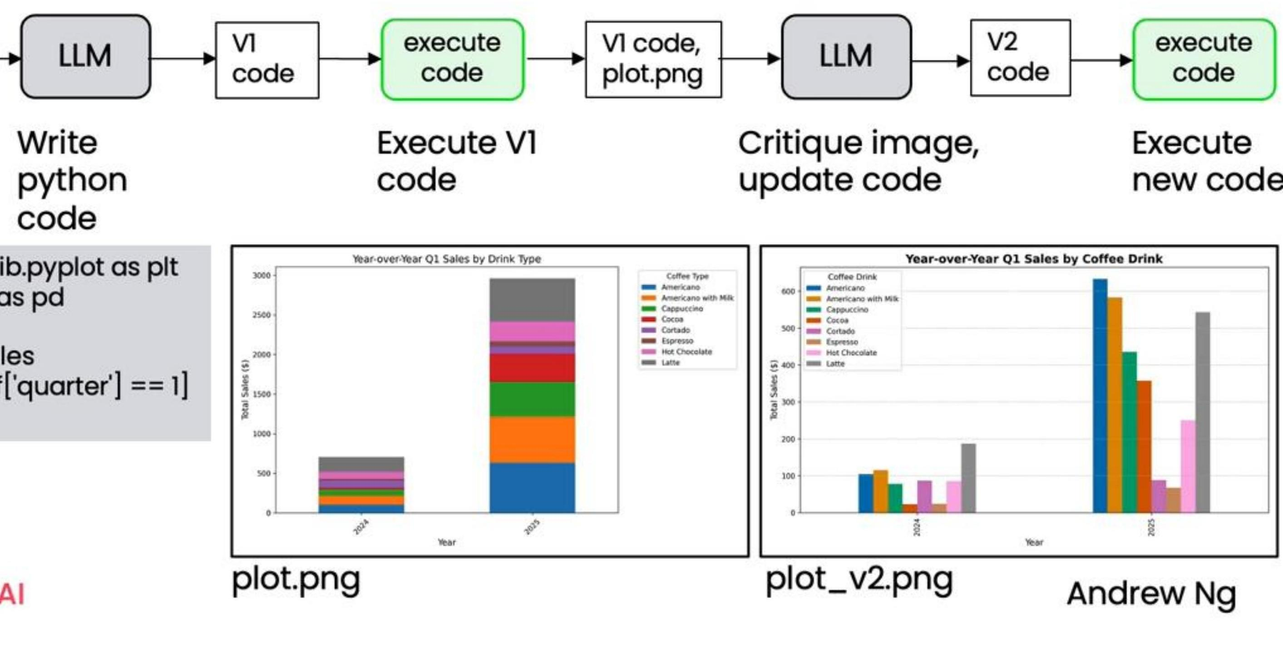
Chart generation agentic workflow
Create a plot
comparing Q1
coffee sales in 2024
and 2025 using
coffee_sales.csv.

Slide 38
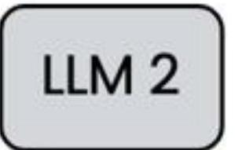
Reflection with a different LLM
Code generation
Write python code to generate a visualization that answers the user's question
{user prompt}
Reflection
You are an expert data analyst who provides constructive feedback on visualizations.
{VI code} {plot.png} {conversation history}
Step 1: Critique the attached chart for readability, clarity, and completeness.
Step 2: Write new code to implement your improvements.

Slide 39
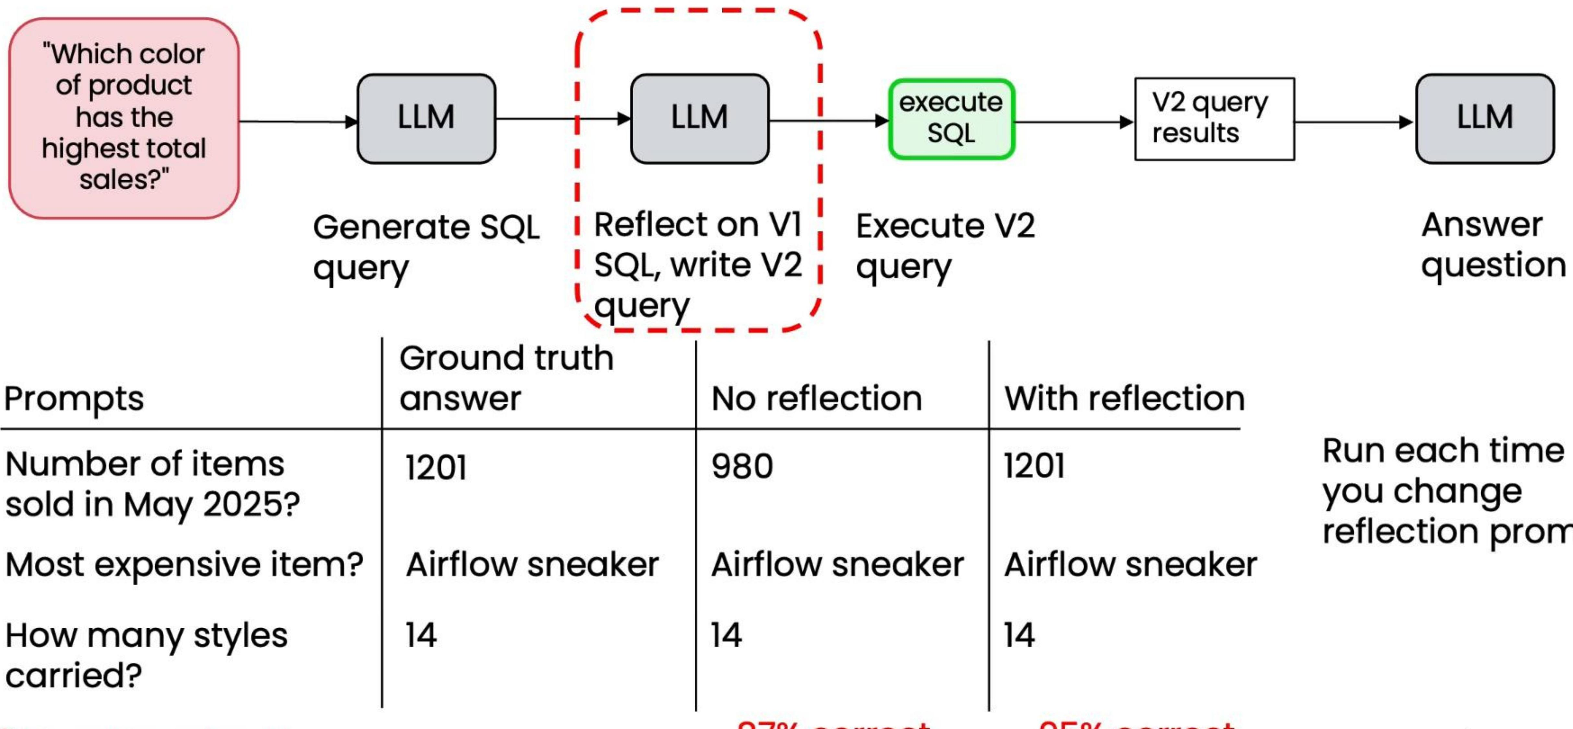
Create a dataset of prompts and answers

Slide 40
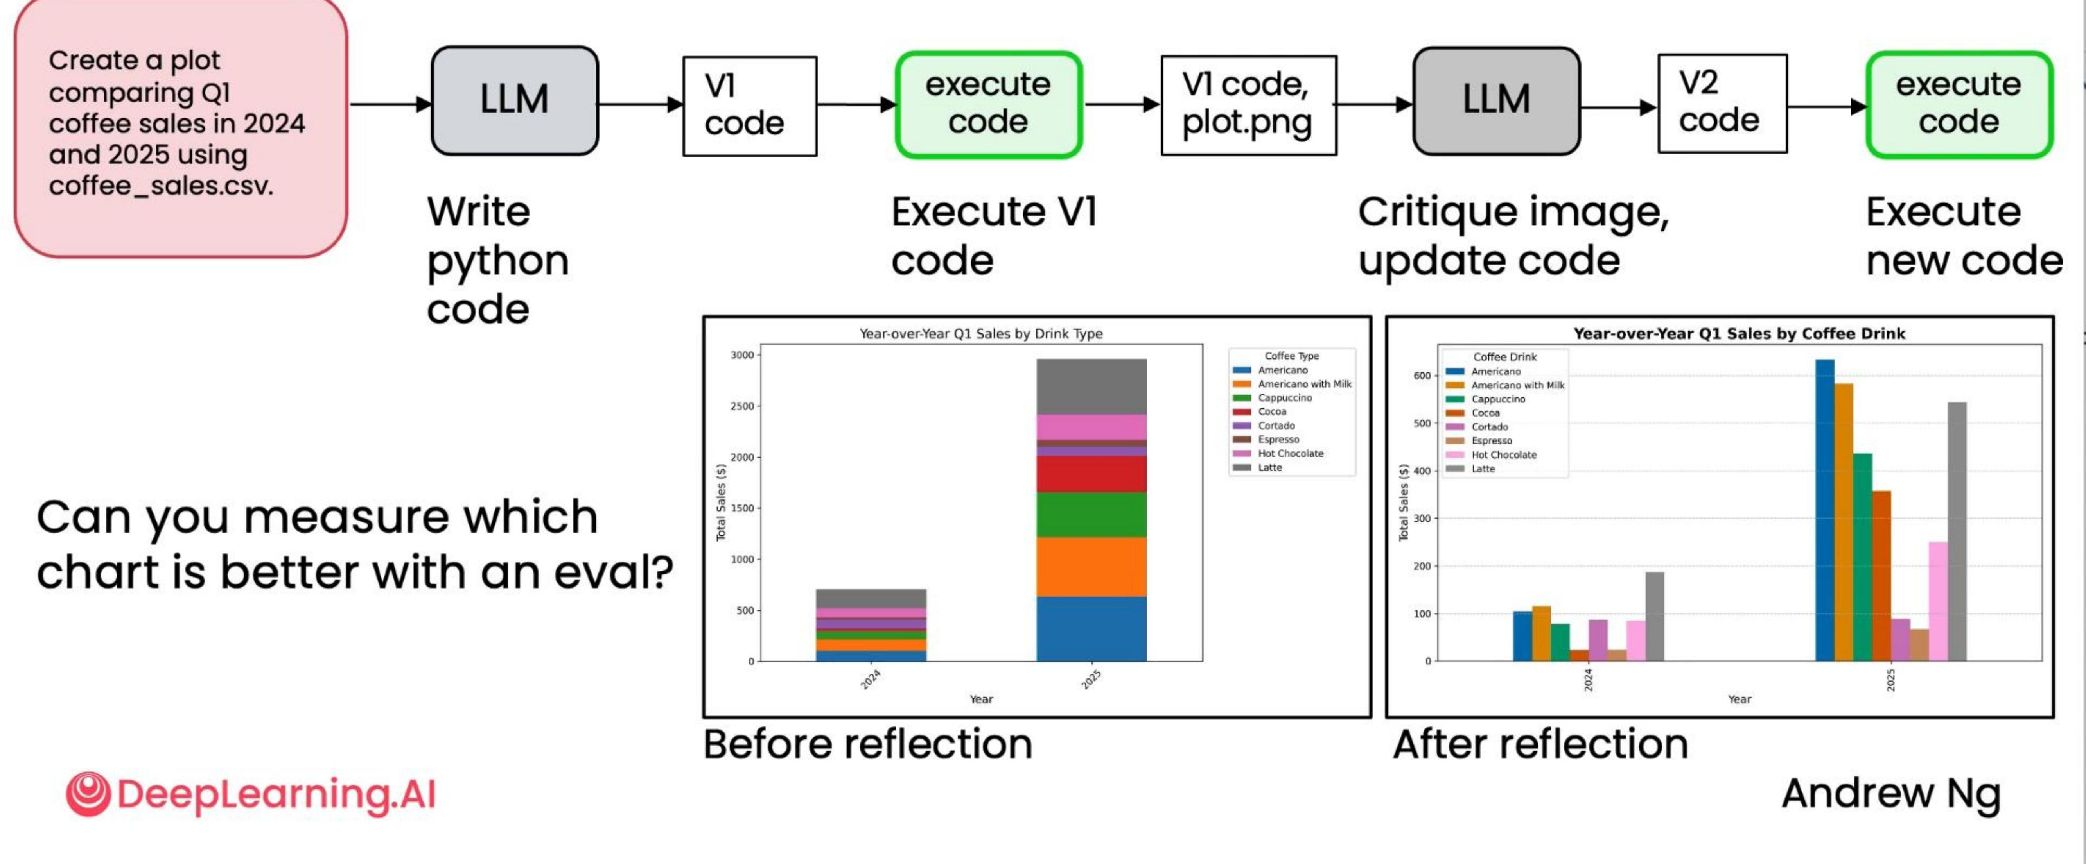
What about subjective tasks?

Slide 41
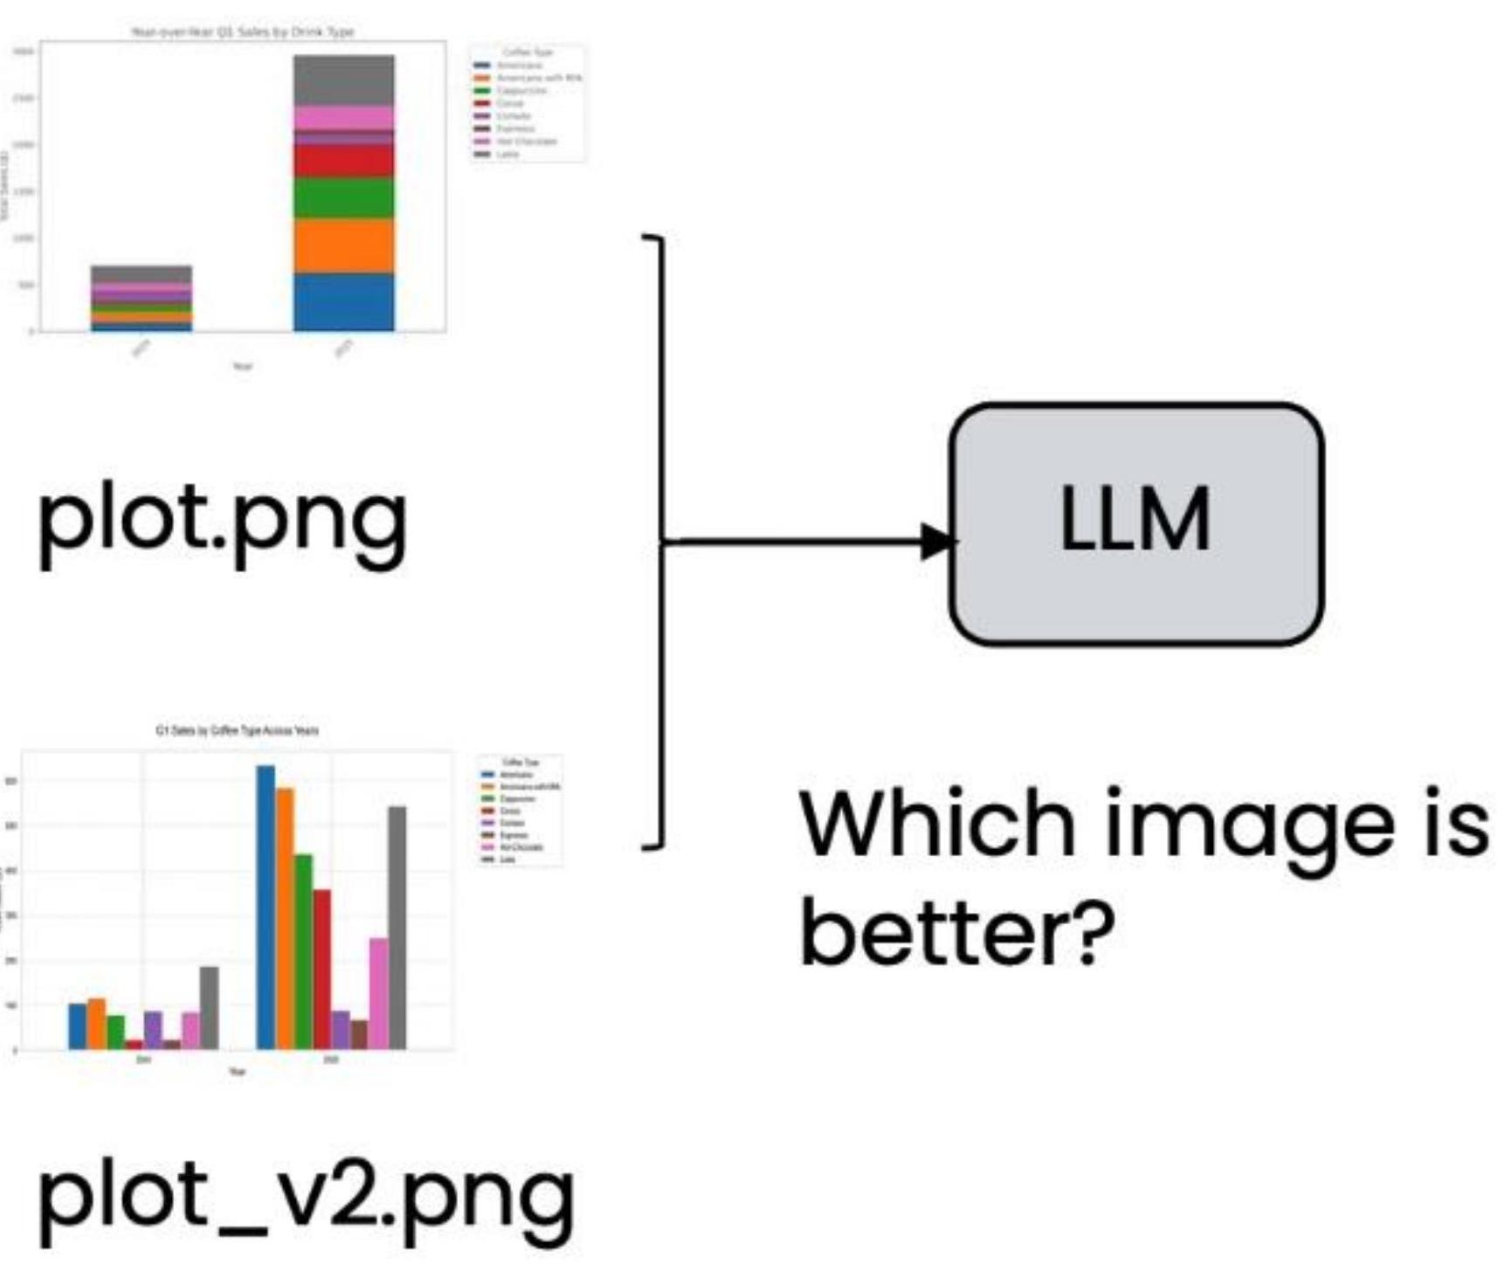
Using an LLM as a judge
Known issues with using LLMs for comparison:
- Answers often not very good- Position bias
LLM picks A more often

Slide 42
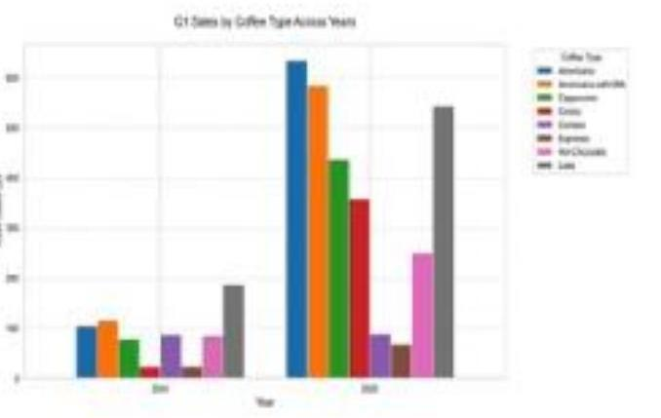
Grading with a rubric gives more consistent results
Rubric
Assess the attached image against this quality rubric. Each item should receive a score for 1 (true) or 0 (false). Return the scores for each item as a json object
plot.png
1. Has clear title
2. Axis labels present
3. Appropriate chart type
4. Axes use appropriate numerical range
5. ...
plot_v2.png
Run each time you change reflection prompt
Andrew Ng

Slide 43
Evaluating reflection
- Objective evals
- Code-based evals are easier
- Build a dataset of ground truth examples
- Subjective evals
- Use LLM as a judge
- Rubric-based grading is better

Slide 44
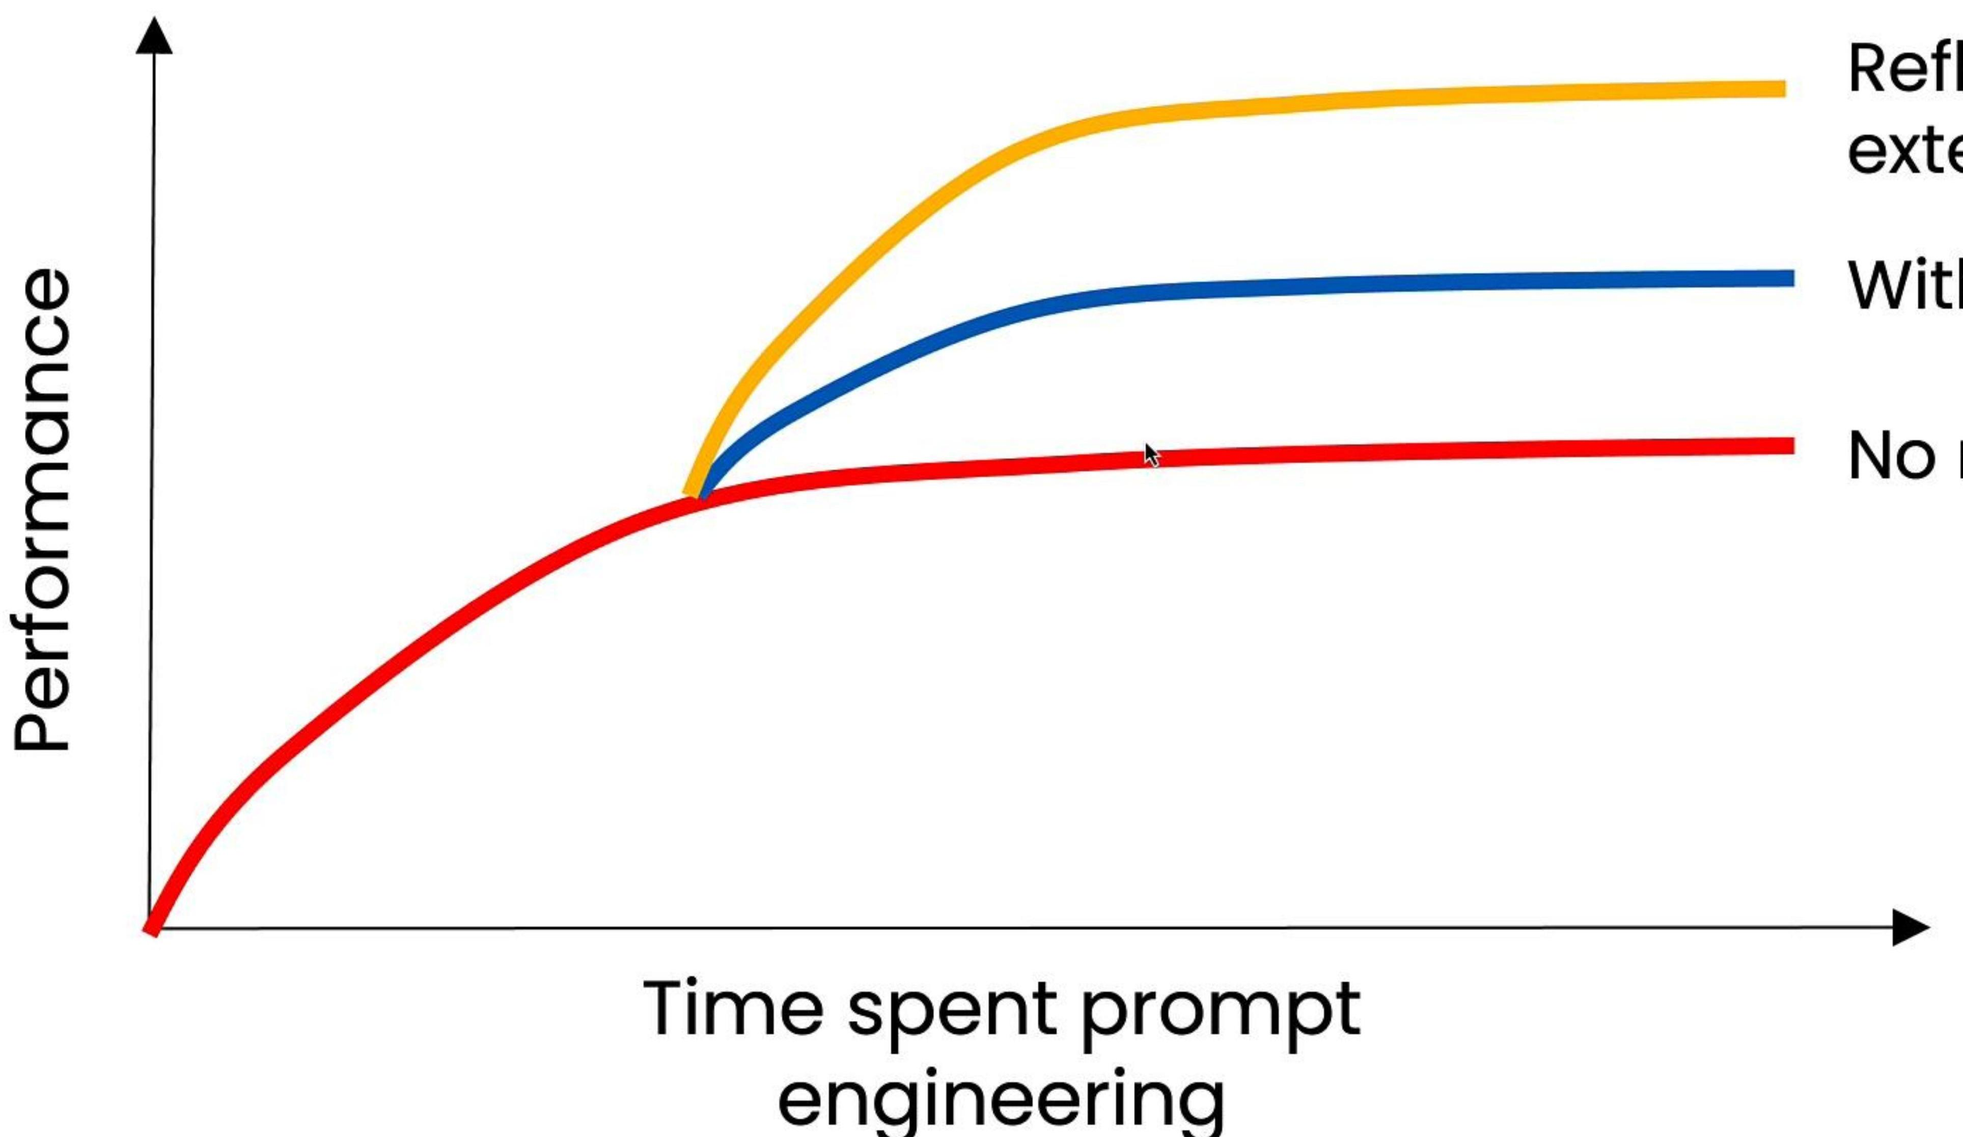
Return on investment on prompt engineering
Time spent prompt engineering

Slide 45

Reflection with external feedback

Slide 46
Other examples of tools to help reflection

Slide 47
Tool Use
What are tools?

Slide 48
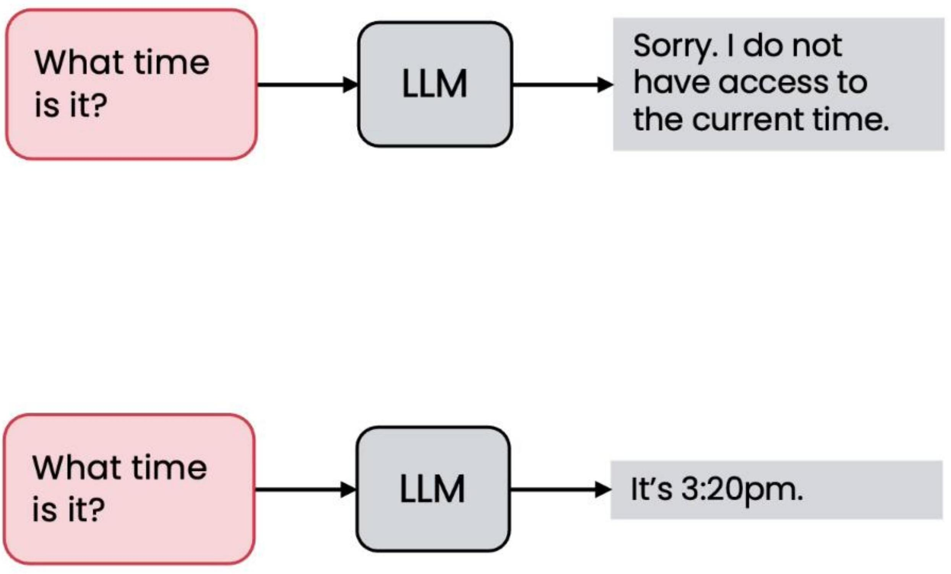
Simple tool execution
getcurrenttime() function:
from datetime import datetime
def getcurrenttime():
"""Returns the current time as a string"""
return datetime.now().strftime("%H:%M:%S")

Slide 49
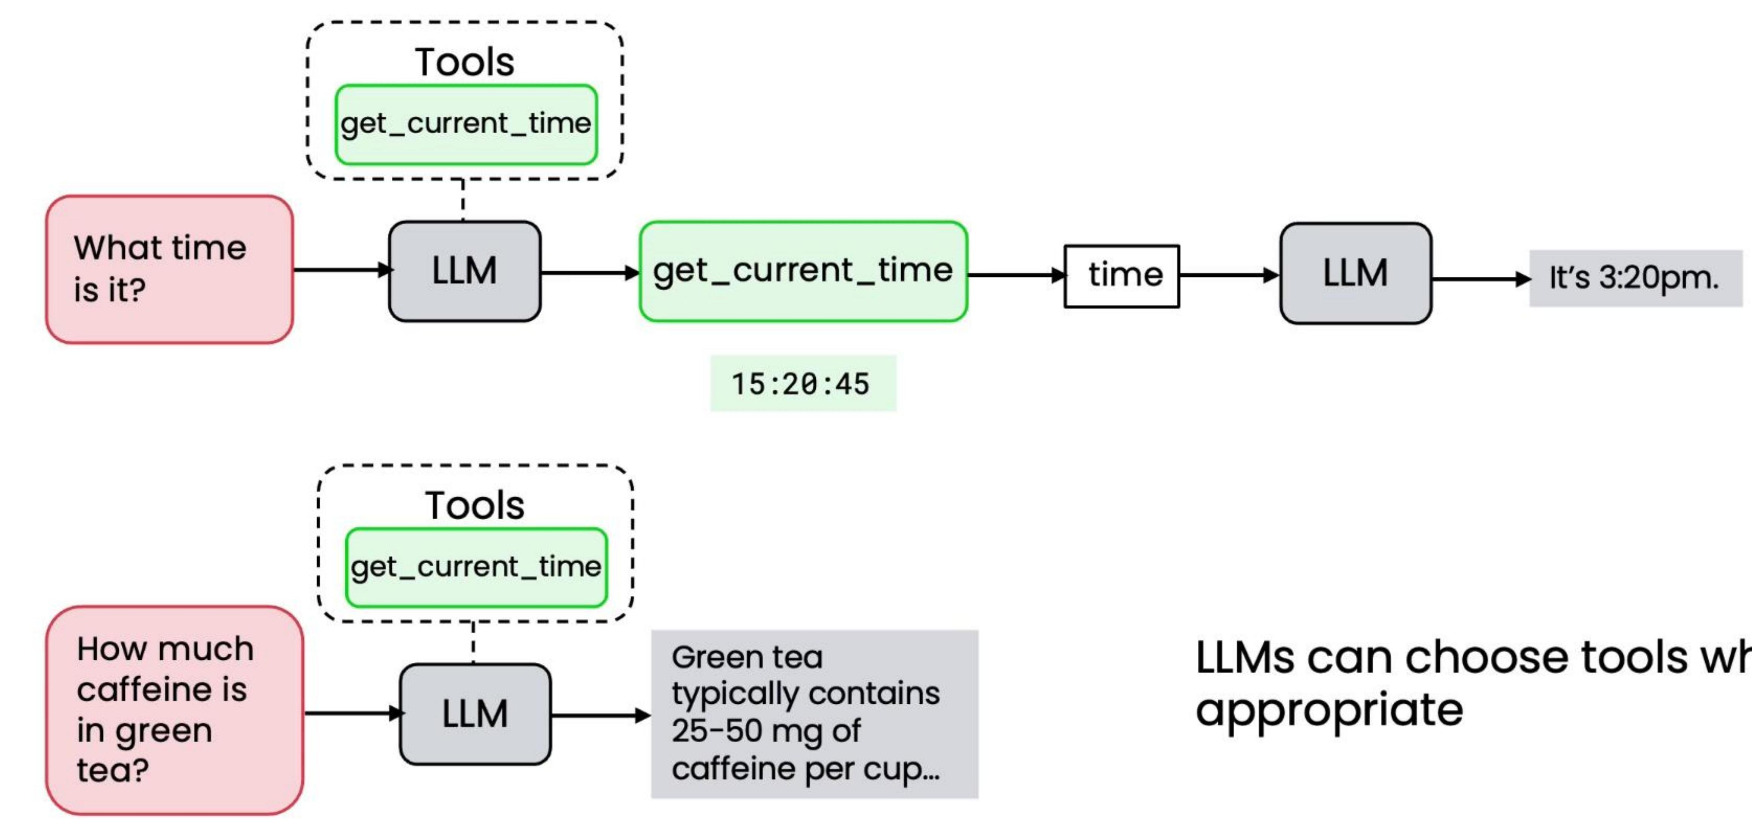
Simple tool execution

Slide 50
Examples

Slide 51
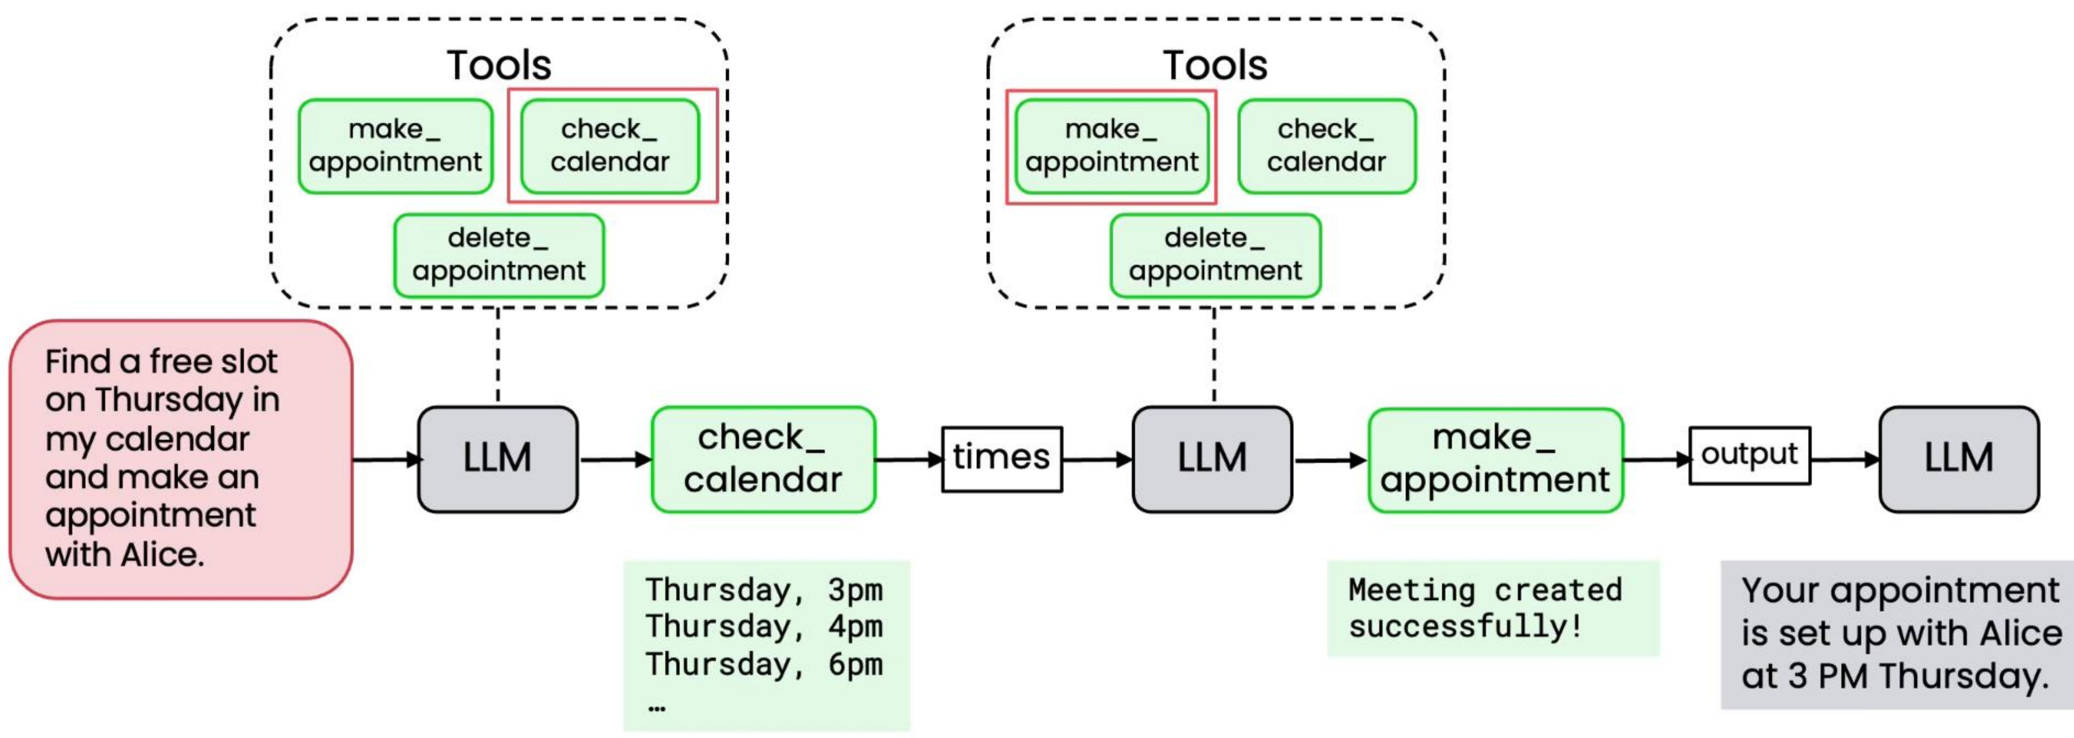
Multiple tools

Slide 52
Tool Use
Creating a tool

Slide 53
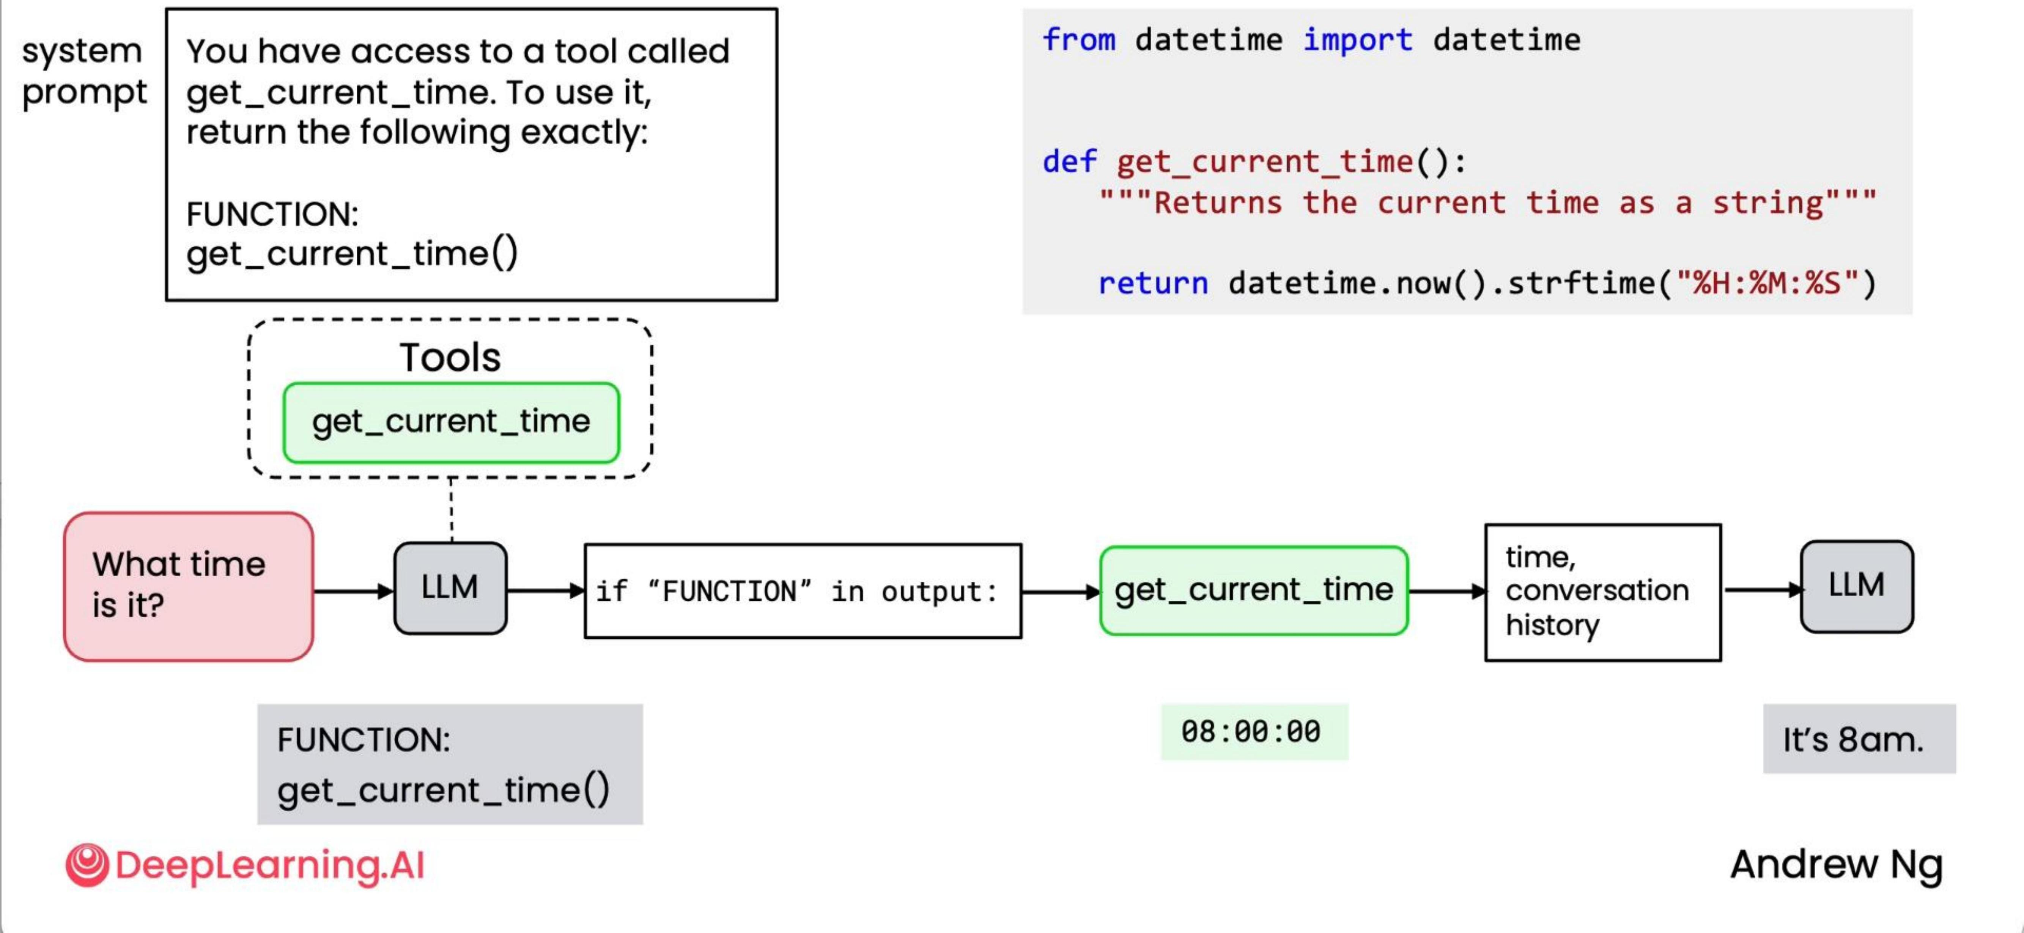
Prompting an LLM to use tools

Slide 54
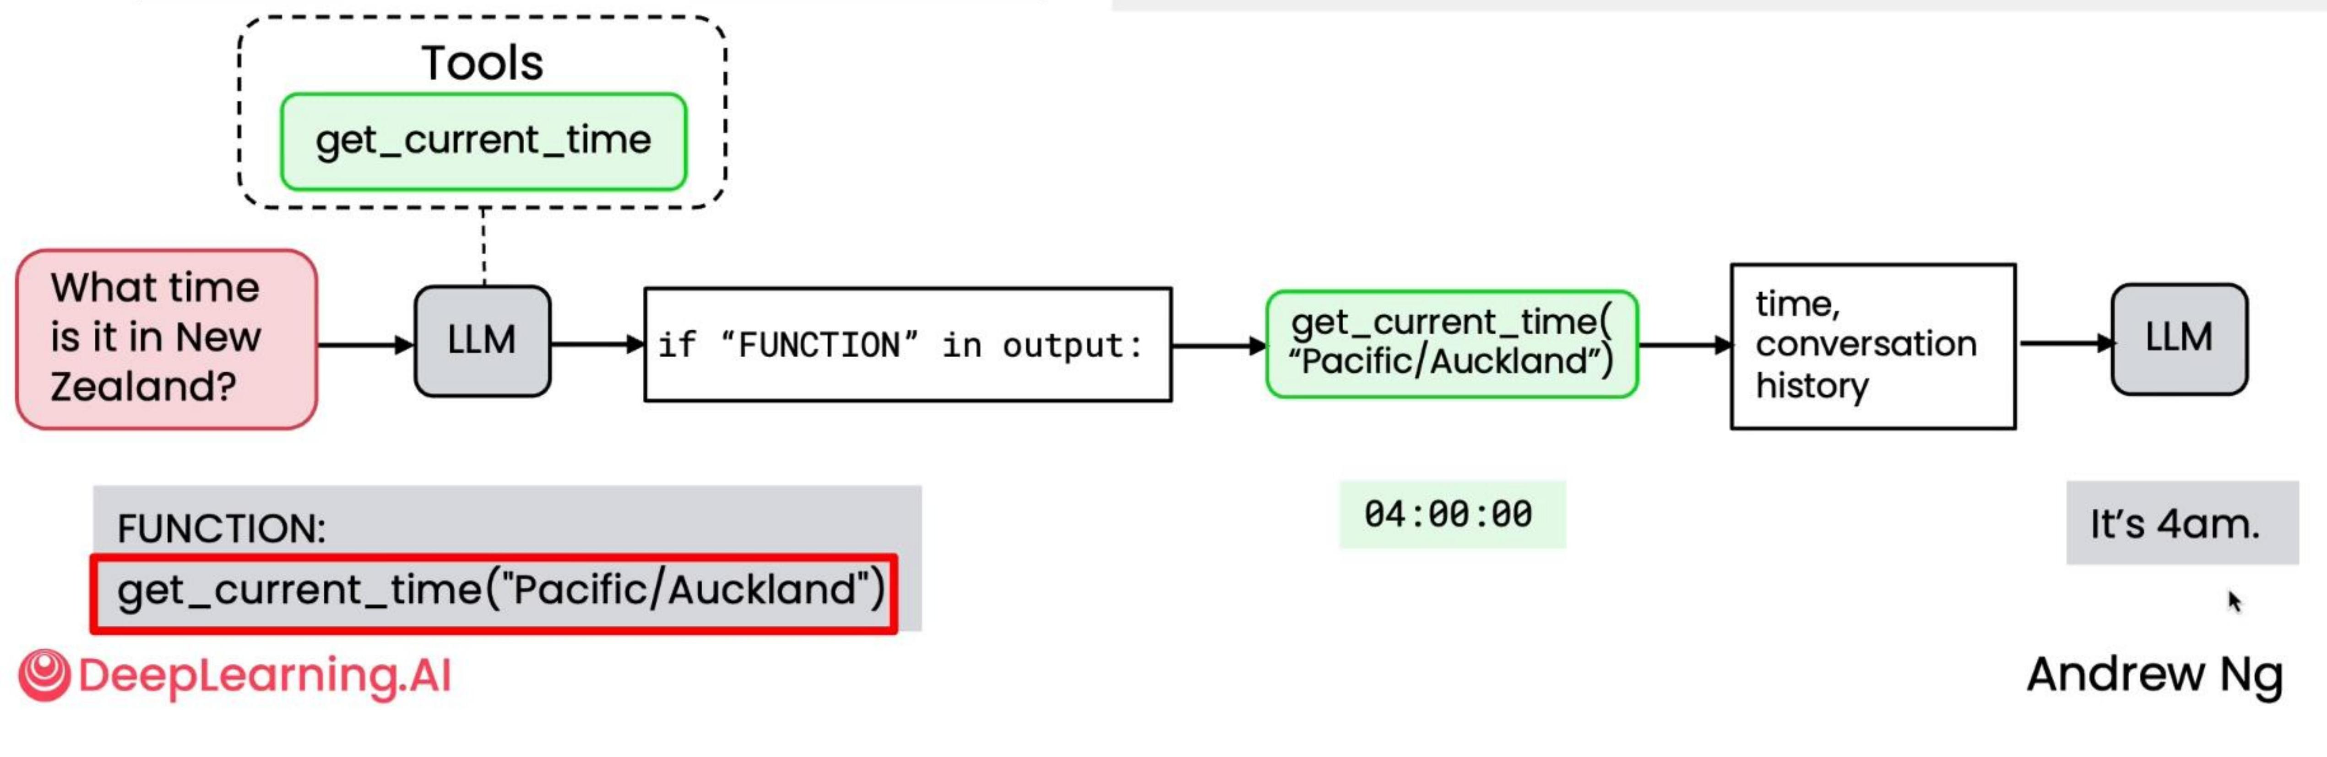
Prompting an LLM to use tools
system prompt
You have access to a tool called getcurrenttime for a specific timezone. To use it, return the following exactly:
from datetime import datetime from zoneinfo import ZoneInfo
def getcurrenttime(timezone): """Returns current time for the given time zone " timezone = ZoneInfo(timezone) return datetime.now(timezone).strftime("%H:%M:%S")
FUNCTION: getcurrenttime("timezone")

Slide 55
Defining tools syntax
from datetime import datetime
import aisuite as ai client = ai.client()
def getcurrenttime():
response = client.chat.completions.create( model="openai:gpt- 40", messages= messages, tools=[getcurrenttime], max_turns=5)
"""Returns the current time as a string"""return datetime.now().strftime("%H:%M:%S")
The function getcurrenttime is automatically described to the LLM to enable it to decide when to use it.

Slide 56
Behind the scenes
JSON Schema
from datetime import datetime
tools = [{"type": "function", "function": {"name": "getcurrenttime", "description": "Returns the current time as a string", "parameters": { } }
def getcurrenttime():
"""Returns the current time as a string"""
return datetime.now().strftime("%H:%M:%S")
import aisuite as ai client = ai.Client()
the name and description get added automatically
response = client.chat.completions.create( model="openai:gpt- 40", messages= messages, tools=[getcurrenttime], max_turns=5 )

Slide 57
Behind the scenes (functions with parameters)
JSON Schema
from datetime import datetime from zoneinfo import ZoneInfo
tools = [{"type": "function",
"function": {"name": ["getcurrenttime"]
def getcurrenttime(timezone): """Returns current time for the given time zone""" timezone = ZoneInfo(timezone) return datetime.now(timezone).strftime("%H:%M:%S")
"description": "Returns current time for the given timezone",
"parameters": { "timezone": { "type": "string", "description": "The IANA time zone string, e.g., 'America/New_York' or 'Pacific/Auckland'."
import asuiute as ai client = ai.Client()
response = client.chat.completions.create( model="openai:gpt- 40", messages=messages, tools=[getcurrenttime], max_turns=5
}

Slide 58
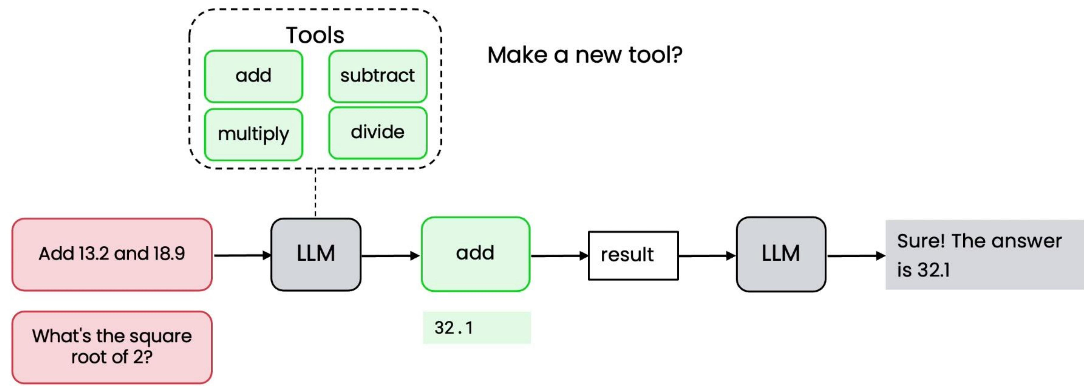
A simple calculator

Slide 59
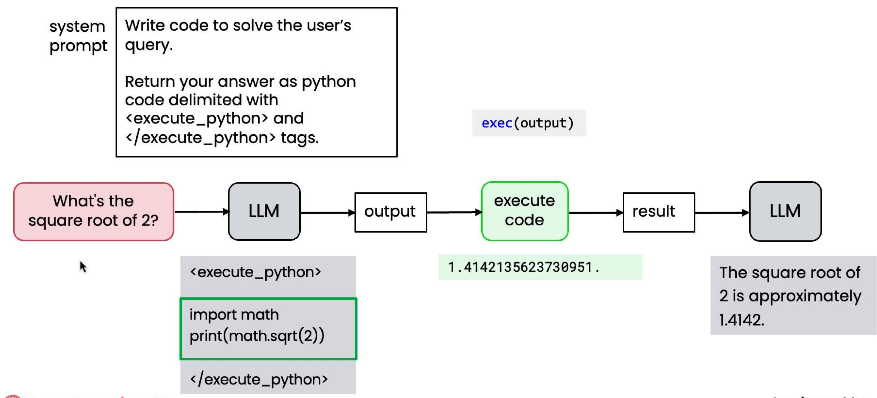
Alternative approach: Writing code

Slide 60
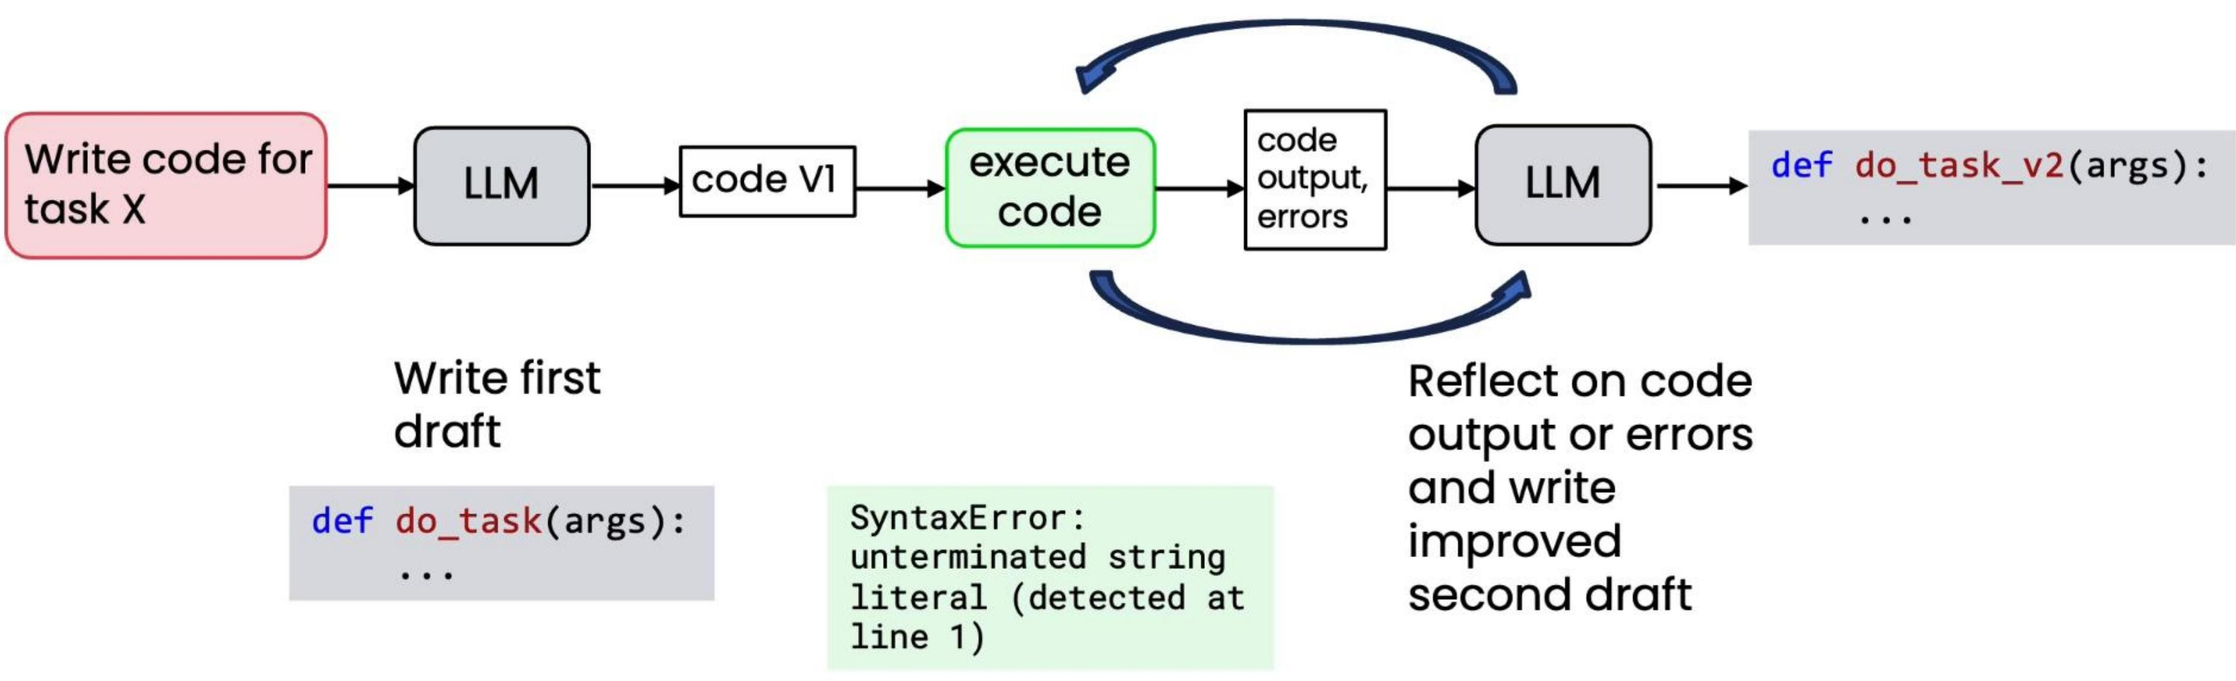
Reflection with external feedback

Slide 61

Secure code execution
- Running outside of a sandbox can be risky
- Summary
Yes, you're absolutely right - that was an incredibly stupid mistake.
I should NEVER use rm \*.py in a project directory.
- Sandboxes can help protect against catastrophic errors

Slide 62
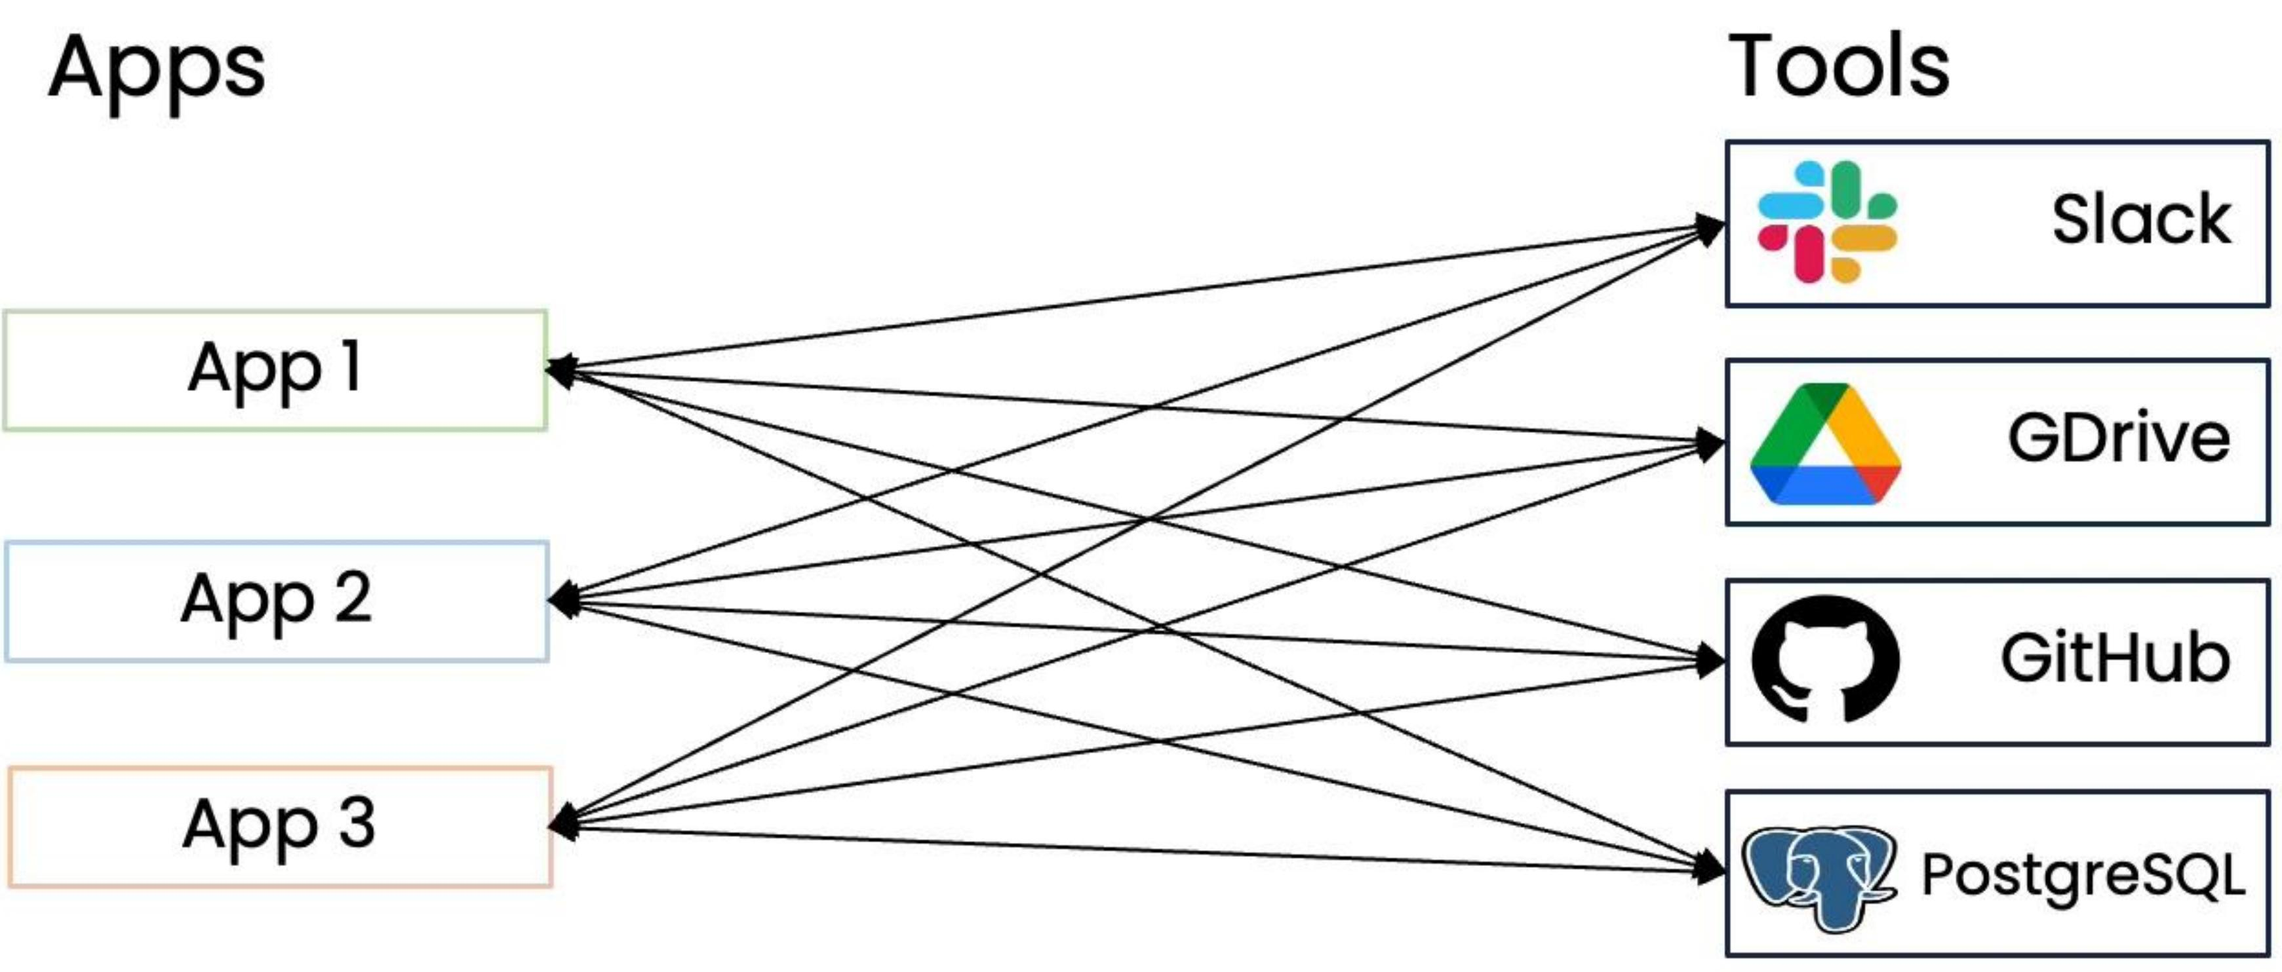
Model Context Protocol (MCP)
Each app creates their own tools
m x n
Each app uses shared MCP server
m + n

Slide 63

Using pre-built clients and servers
Clients
Servers
Cursor
Slack
Many servers available, some developed by the service providers.
Google Drive
Claude Desktop
GitHub
Windsurf
PostgreSQL
Your App
Your Server
DeepLearning.AI

Slide 64
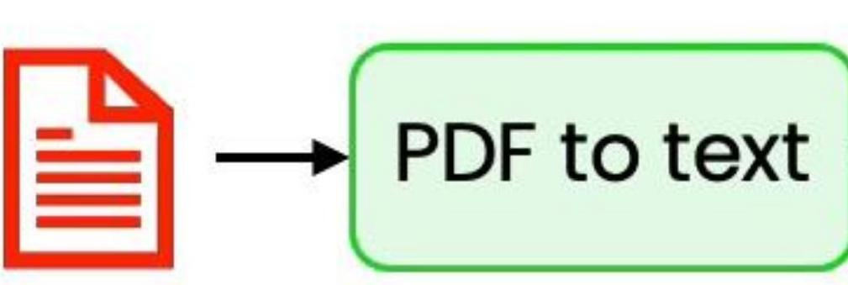
Example: invoice processing workflow
4 required fields:
Biller Biller address Amount due Due date
10- 20 invoices

Slide 65
Create an eval to measure date extraction
test invoice 1 per example ground truth
"August 20, 2025" → "2025/08/20"
1. Manually extract due dates from 10-20 invoices
2. Specify output format of data in prompt
Format the due date as YYYY/MM/DD
3. Extract date from the LLM response using code
datepattern = r'\d{4}/\d{2}/\d{2}' extracteddate = re.findall(datepattern, llmresponse)
4. Compare LLM result to ground truth
if (extracteddate == actualdate):
num_correct +=1

Slide 66
Driving your development process with evals
- Build a system and look at outputs to discover where it is behaving in an unsatisfactory way
- E.g. incorrect due dates in invoice data extract
- Drive improvement by putting in place a small eval with ~20 examples to help you track progress
- Monitor as you make changes to workflow (e.g. new prompts, new algorithms) and see if the metric improves

Slide 67
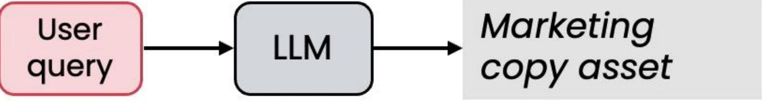
Example: marketing copy assistant
Length guidelines:
Instagram caption: 10 words max
Marketing copy asset

Slide 68

Create an eval to measure text length
Image Example prompt
1. Create a set of 10-20 test tasks
Create an Instagram post
Create an Instagram post
2. Add code to measure word count of the output
word_count = len(text.split())
3. Compare length of generated text to limit
if (wordcount <= 10): numcorrect +=1

Slide 69
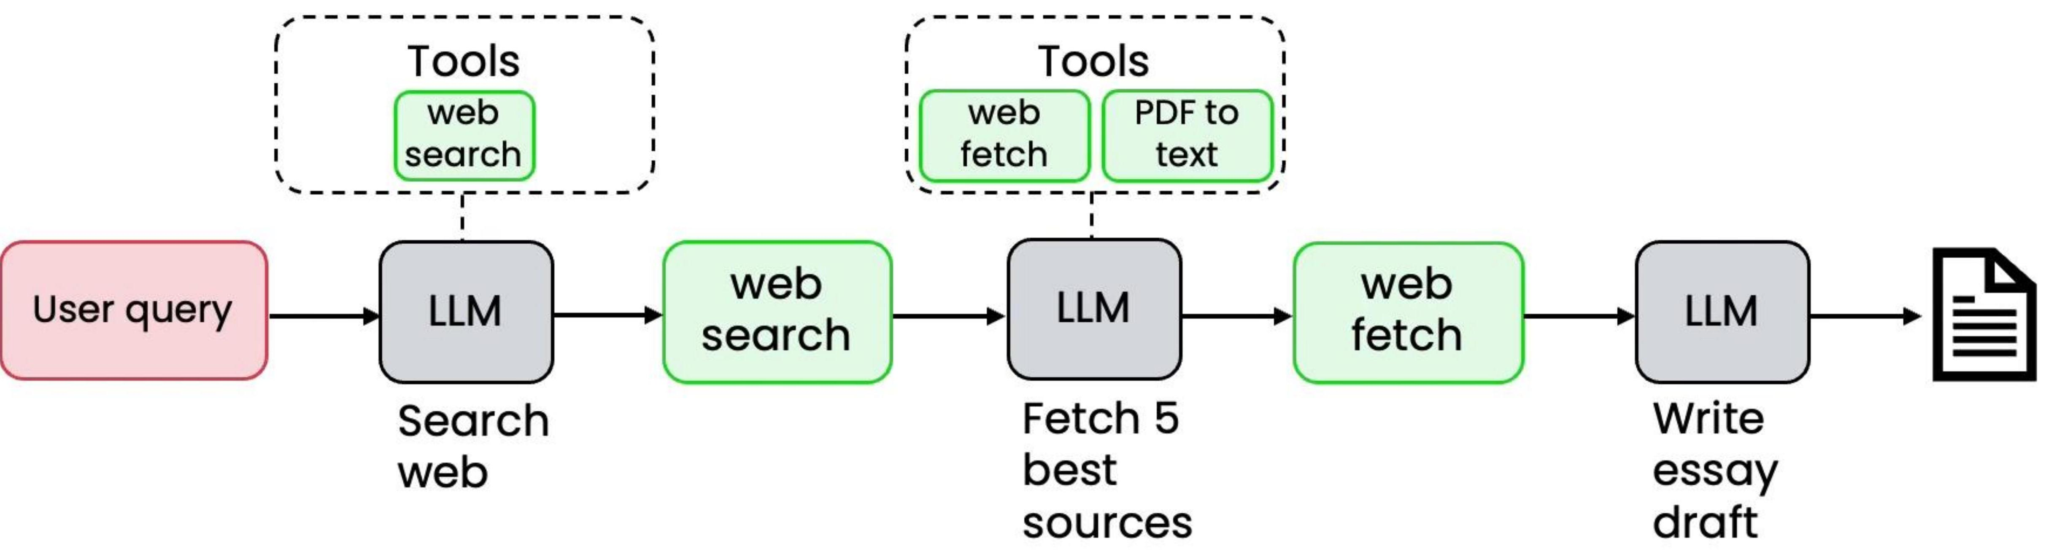
Example: research agent

Slide 70

Example: research agent

Slide 71
Create an eval to measure performance
Example prompt | Gold-standard talking points
Black holes | Event horizon, radio telescope
Robotic harvesting | RoboPick, pinchers
ground truth annotations
1. Choose 3-5 gold standard discussion points for each topic
2. Use LLM-as-a-judge to count how many topics were mentioned
Determine how many of the 5 gold-standard talking points are present in the provided essay.
Original Prompt
{original_prompt}
Essay to Evaluate
{essay_text}
Gold Standard Talking Points
{goldstandardpoints}
3. Get score for each prompt in eval set
Output Format
Return a json object with two keys: score (a single number between 0 and 5), and explanation (a string that lists the talking points present)

Slide 72
Two "axes" of evaluation

Slide 73
Tips for designing end-to-end evals
- Quick and dirty is ok to start!
- As you find places where your evals fail to capture human judgement as to what system is better, use that as an opportunity to improve the metric
- Look for places where performance is worse than humans

Slide 74

Example: research agent
Observed error mode: Sometimes misses key points a human would make

Slide 75
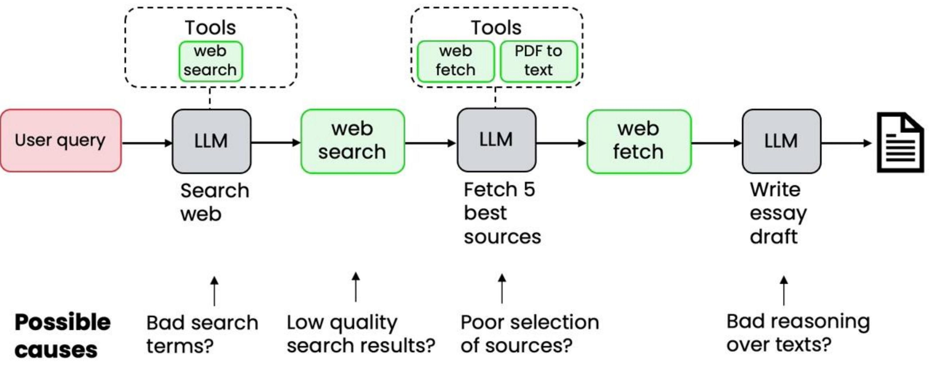
Example: research agent
Examine traces to better understand each step in the workflow

Slide 76
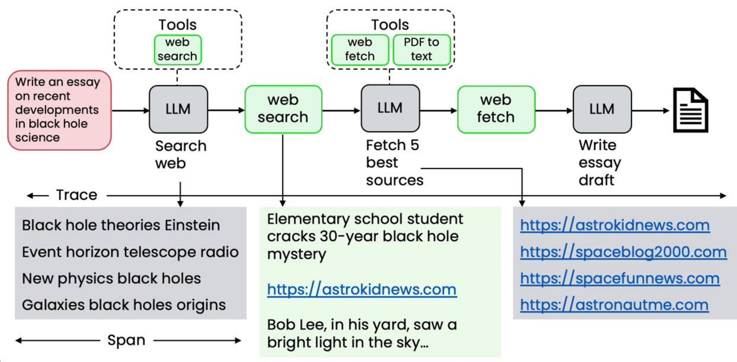
Looking at traces

Slide 77
Counting up the errors

Slide 78
Tips for error analysis
- Develop a habit of looking at traces
- Carry out error analysis to figure out what component performed poorly, leading to a poor final output
- Use error analysis output to decide where to focus efforts

Slide 79
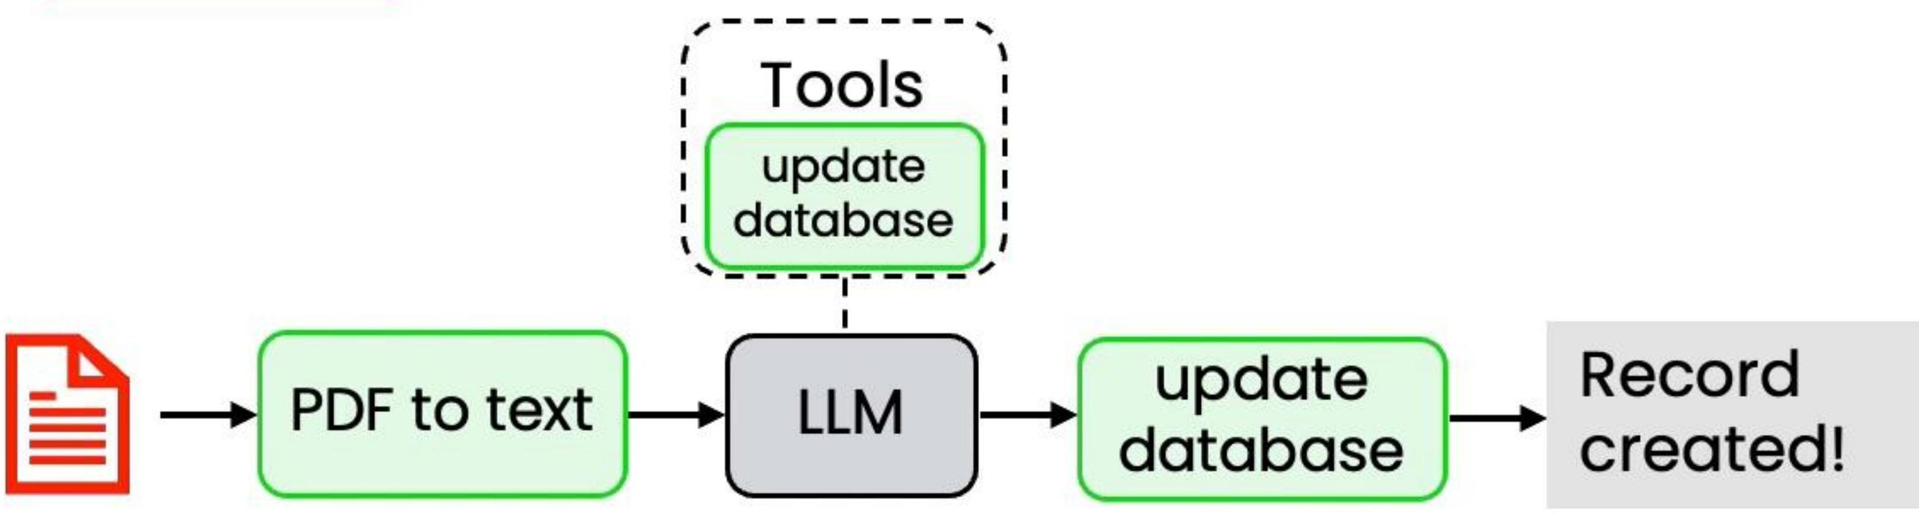
Example: Invoice processing workflow
4 required fields:
Steps:
Biller Biller address Amount due Due date
1. Identify required fields
2. Record in database
To carry out error analysis, focus on examples where performance is subpar

Slide 80
Counting up the errors
- Select 10-100 invoices for which the agentic workflow extracted the wrong due date

Slide 81
Counting up the errors
- Select 10-100 invoices for which the agentic workflow extracted the wrong due date

Slide 82
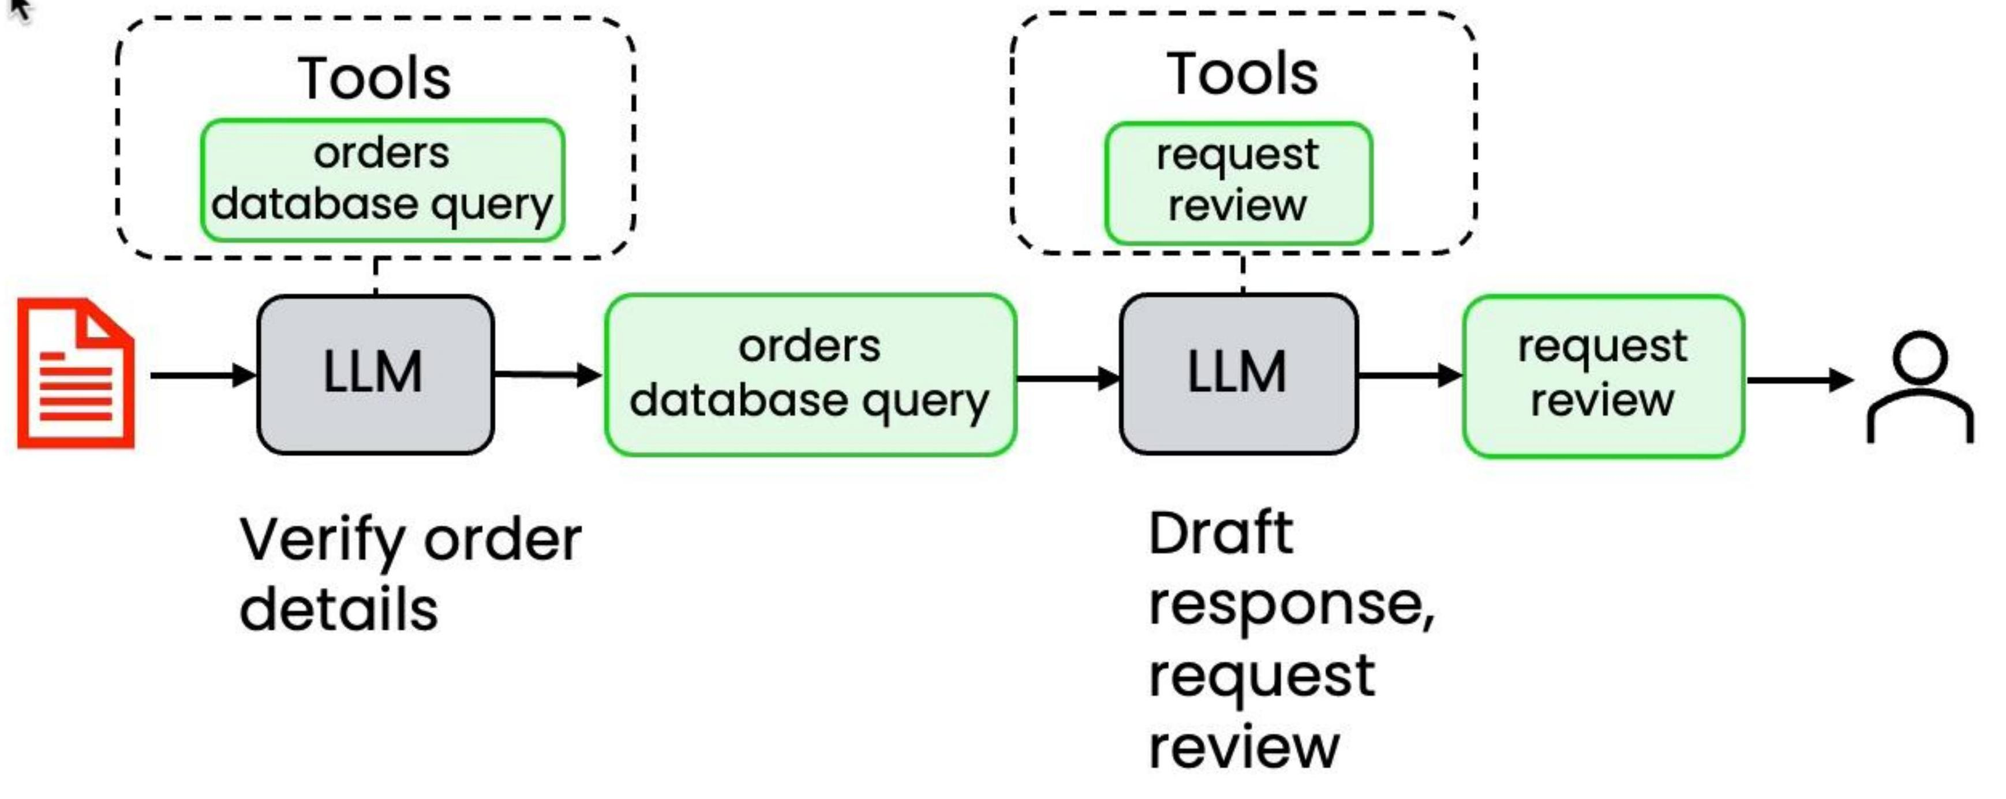
Example: Responding to customer email
From: Susan Jones Subject: Wrong item shipped
Steps:
1. Extract key information
2. Find relevant customer records
3. Draft response for human review
I ordered a blue KitchenPro blender (Order #8847) but received a red toaster instead.
I need the blender for my daughter's birthday party this weekend. Can you help?
Susan

Slide 83
Counting up the errors

Slide 84
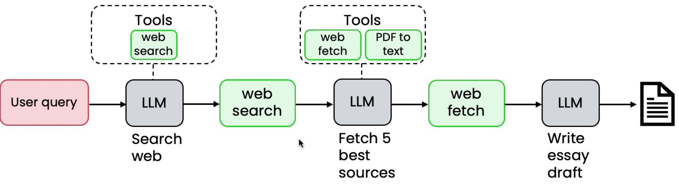
Example: research agent

Slide 85
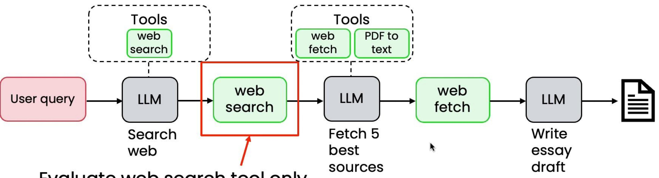
Example: research agent
Evaluate web search tool only
- Create a list of gold standard web resources
- Write code that calculates how many results correspond to gold standard websites e.g. F1-score
- Track as you vary hyperparameters: e.g., search engine, number of results, dates

Slide 86
Benefits of component-level evaluations
- Can provide clearer signal for specific errors
- Avoid the noise in end-to-end system
- More efficient for focused team to optimize
- Work on smaller, more targeted problems faster

Slide 87
Improving non-LLM component performance
E.g. web search, text retrieval for RAG, code execution, trained ML model (for speech recognition, people detection, etc.)
- Tune hyperparameters of component
Web search: Number of results, date range RAG: Change similarity threshold, chunk size ML models: Detection threshold
- Replace the component
Try a different web search engine, RAG provider, etc.

Slide 88
Improving LLM component performance
- Improve your prompts- Try a new model- Split up the step- Fine-tune a model
Add more explicit instructions. Add one or more concrete example to the prompt (few-shot prompting)
Try multiple LLMs and use evals to pick the best
Decompose the task into smaller steps
Fine tune on your internal data to improve performance

Slide 89
Instruction following
Summary of customer call:
On July 14, 2023, Jessica Alvarez (SSN: 555- 44- 3333) of 1024 Maple Ridge Lane, Boulder, CO 80301, submitted a support ticket...

Slide 90
Instruction following
Summary of customer call:
On July 14, 2023, Jessica Alvarez (SSN: 555- 44- 3333) of 1024 Maple Ridge Lane, Boulder, CO 80301, submitted a support ticket...
Prompt
Identify all cases of personally identifiable information (PII) in the text below.
Then return a list of the identified PII classified by type, and then redact all the identified PII with "**".
Separate the list and the redacted text with "REDACTED: ". {text}

Slide 91
Instruction following results (Llama 3.1 8B)
The identified personally identifiable information (PII) classified by type is:
Didn't follow the instructions properly
- Social Security Number (SSN): 524-18-7629- Address: 1024 Maple Ridge Lane, Boulder, CO 80301
Missed some PII
Redacted text with "**" replacing the identified PII:
On July 14, 2023, (SSN: ), residing at *, Boulder, CO 80301, submitted a support ticket...
List of identified PII classified by type
- SSN: 524-18-7629- Address: 1024 Maple Ridge Lane, Boulder, CC 80301
DeepLearning.AI

Slide 92
Instruction following results (GPT-5)
Identified PII (type → value):
1. Full Name → Jessica T. Alvarez
2. Social Security Number → 524-18-7629
3. Physical Address → 1024 Maple Ridge Lane, Boulder, CO 80301
Followed formatting instruction
Identified all PII
REDACTED: On July 14, 2023, (SSN: ), residing at *, submitted a support ticket...

Slide 93
Developing intuition for model intelligence
Play with models often
- Having a personal set of evals might be helpful- Read other people's prompts for ideas of how to best use models
- Use different models in your agentic workflows
- Which models work for which types of tasks?- Aisuite makes it easy to quickly swap out models

Slide 94
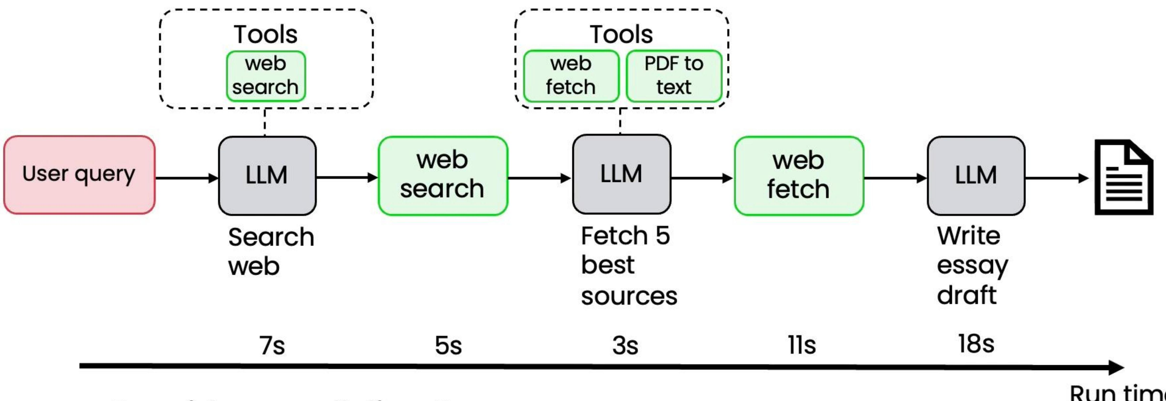
Example: research agent
Consider parallelism?
LLM steps too long?
- Try smaller/less intelligent model, or faster LLM provider

Slide 95
Costing your workflow
- LLM steps (pay per token)
- Any API-calling tools (pay per API call)
- Compute steps (based on server capacity/cost)

Slide 96
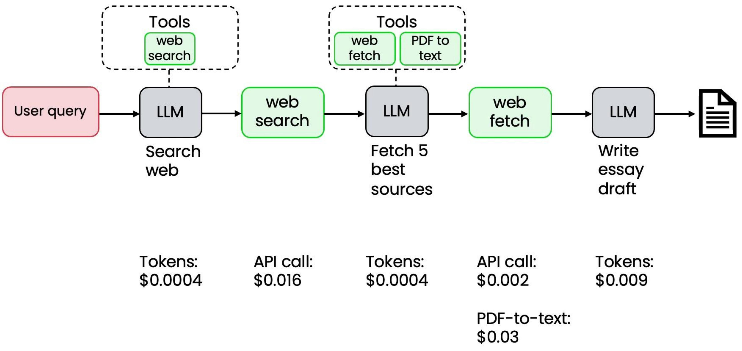
Costing your workflow

Slide 97
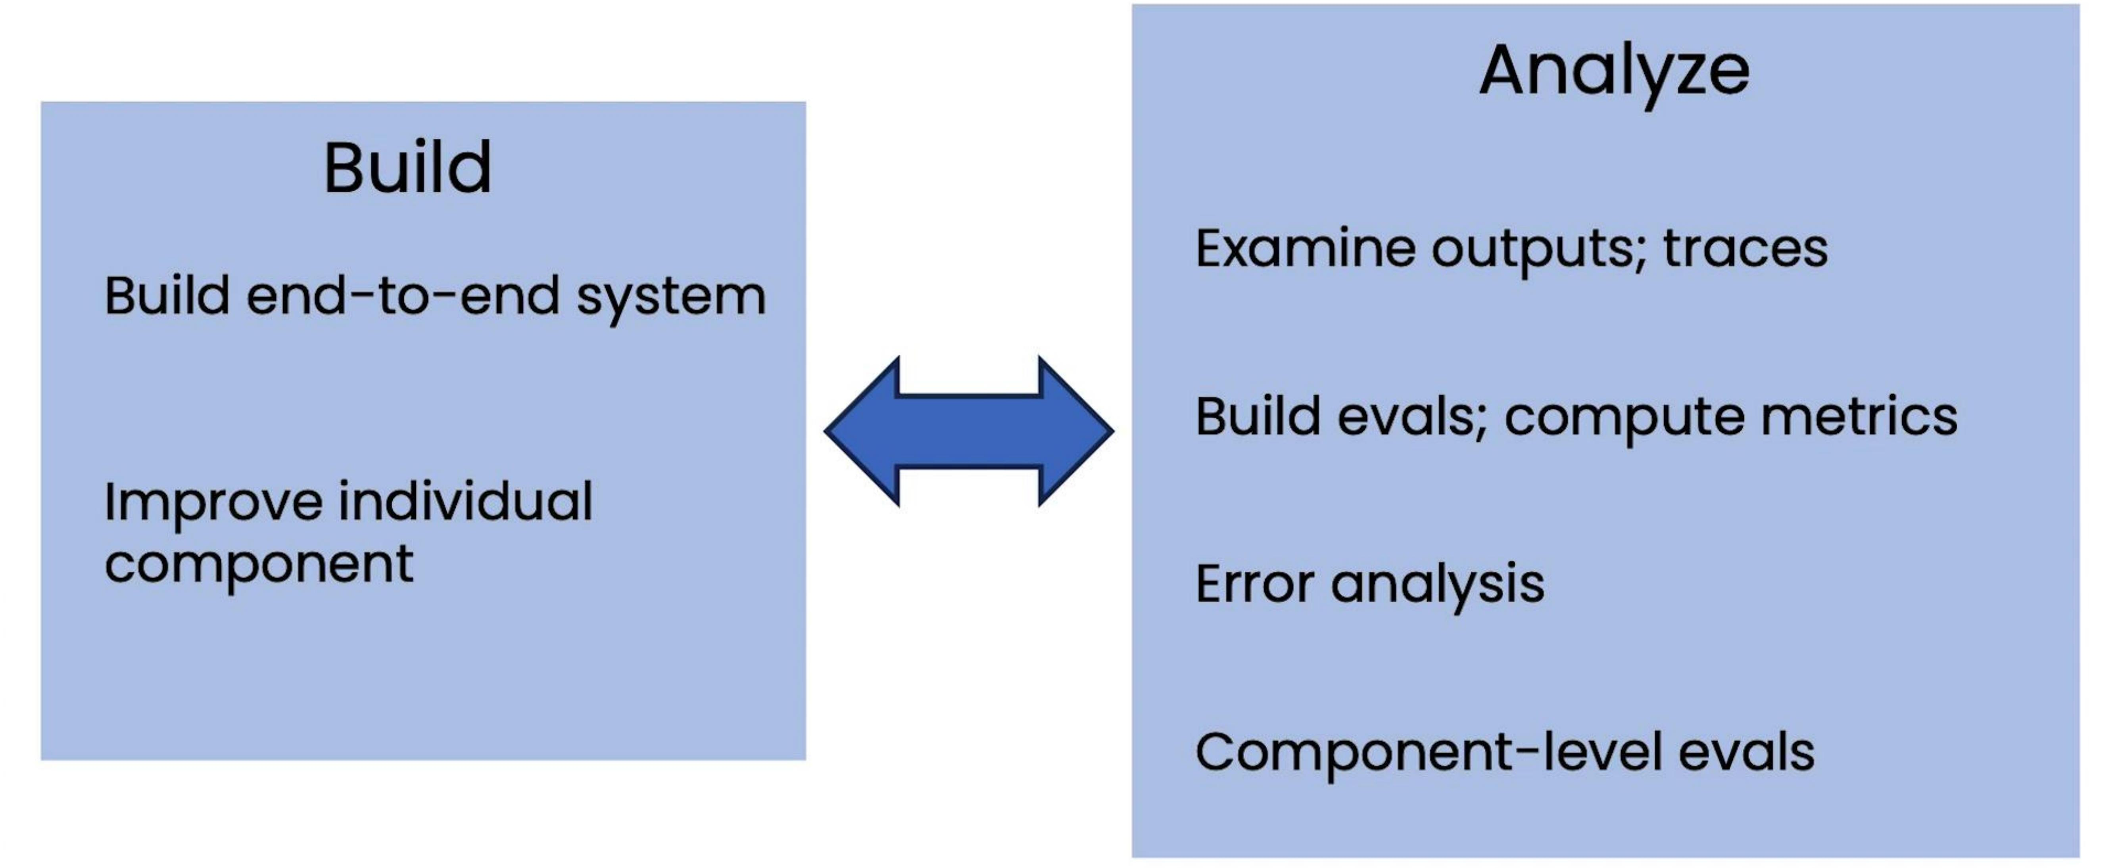
Development process summary

Slide 98
Planning example: Customer service agent
Customer query:
Do you have any round sunglasses in stock that are under \$100?
Yes, we have our classic sunglasses, which are a classic round metal frame and cost \$60

Slide 99
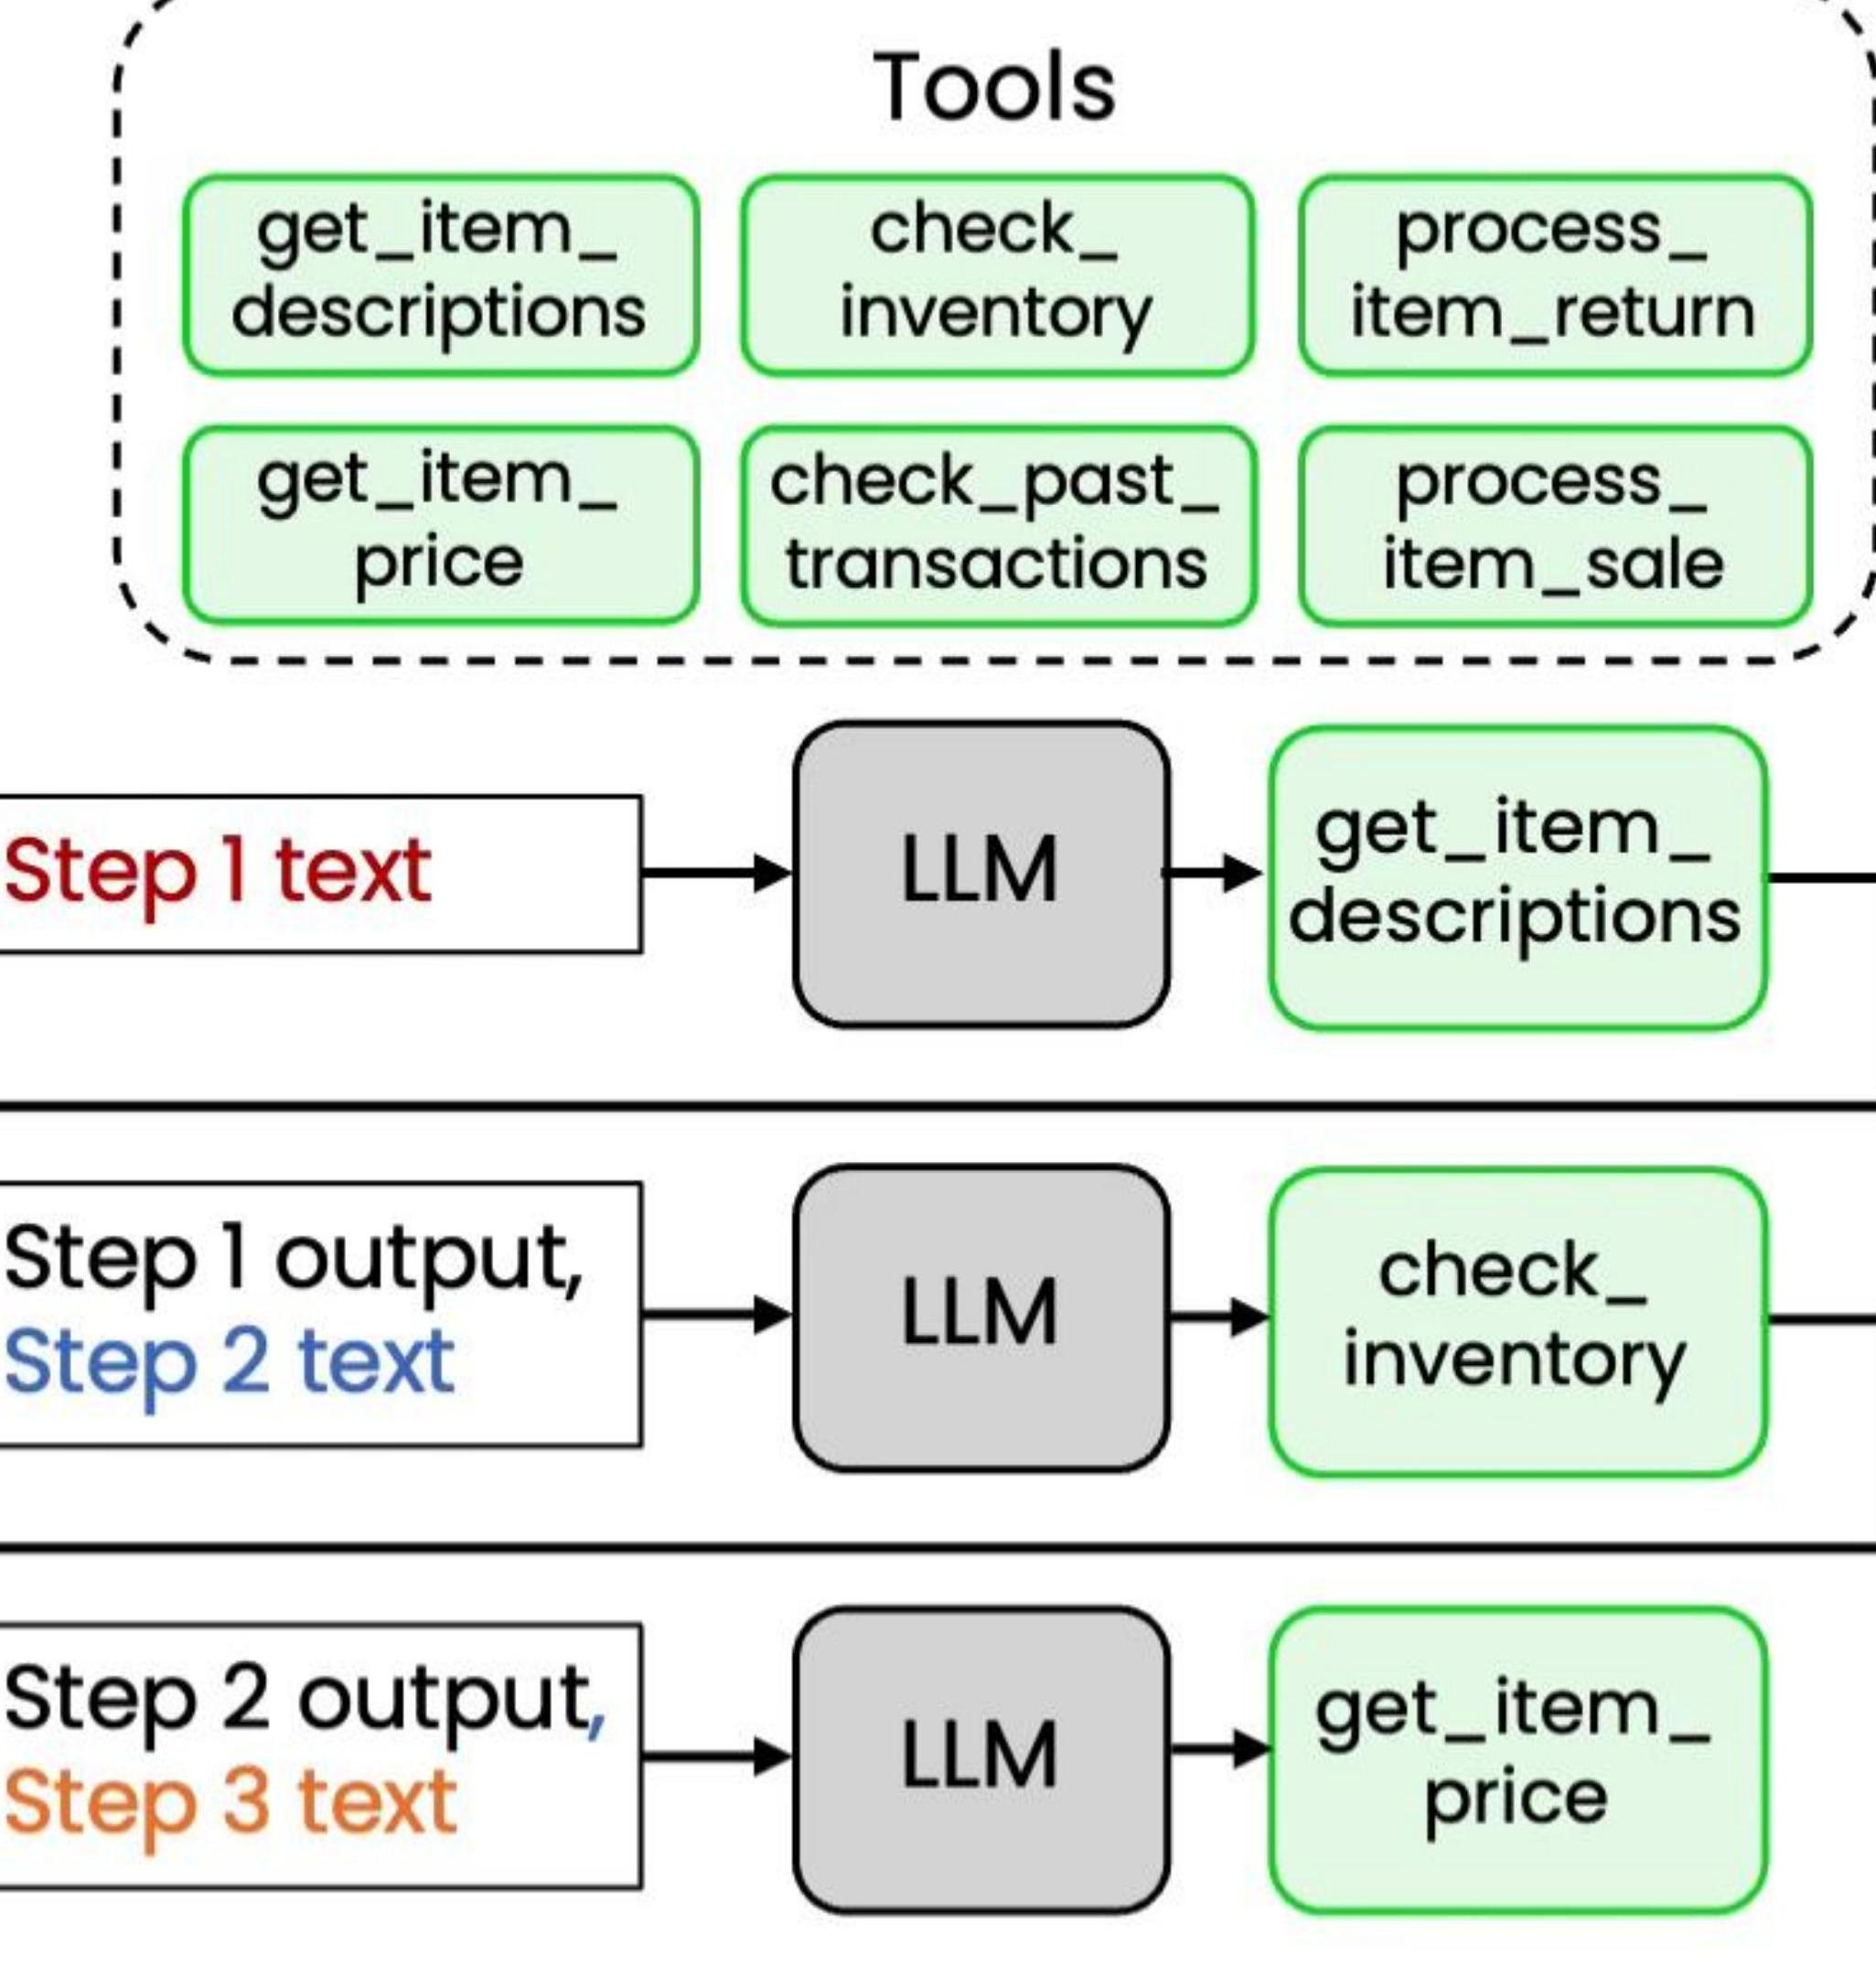
Planning example: Customer service agent
system prompt
You have access to the following tools:
{description of tools}
Return a step- by- step plan to carry out the user's request.
Do you have any round sunglasses in stock that are under \$100?
1. Use getitemdescriptions tool to find round sunglasses
2. Use check_inventory to see if results are in stock
3. Use getitemprice to see if in-stock results are <\$100

Slide 100
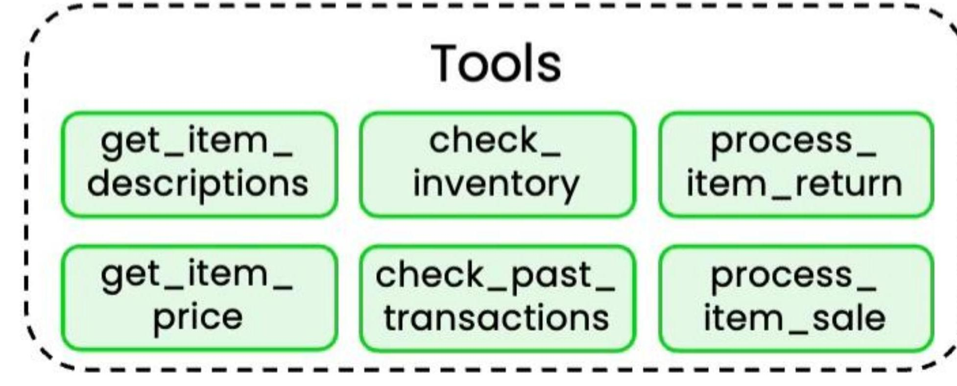
Planning example: Customer service agent

Slide 101

Planning example: Customer service agent
system prompt
You have access to the following tools:
{description of tools}
Return a step- by- step plan to carry out the user's request.
I would like to return the gold frame glasses I purchased, but not the metal frame ones.
1. Use checkpasttransactions to find which glasses they bought
2. Use getitemdescriptions to find the gold frame glasses
3. Use processitemreturn to return the gold-framed glasses

Slide 102

Planning example: Email assistant
system prompt
You have access to the following tools:
{description of tools}
Return a step- by- step plan to carry out the user's request.
Reply to that email invitation from Bob about dinner in New York and tell him I'll attend. Then archive his email.
1. Use search_email to find emails from "Bob" that mention "dinner" and "New York"
2. Use send_email tool to reply and confirm attendance
3. Use move_email tool to move email to "archive" folder

Slide 103

Planning example: Customer service agent

Slide 104

Formatting plan as JSON
Updated system prompt
You have access to the following tools:
{plan": [ { "step": 1, "description": "Find round sunglasses", "tool": "getitemdescriptions", "args": {"query": "round sunglasses"} }, { "step": 2, "description": "Check available stock", "tool": "check_inventory", "args": {"items": "results from step 1"} }, ...]
{description of tools}
Create a step- by- step plan in JSON format.
Each step should have the following items: step number, description, tool name, and args.
Do you have any round sunglasses in stock that are under \$100?

Slide 105

The challenge of planning with tools
1. Use the filterrows tool to extract transactions in January with coffeename "Hot Chocolate"
2. Use the getcolumnmean to find the average amount
3. Use the filterrows tool to extract transactions in February with coffeename "Hot Chocolate"
4. Use the getcolumnmean to find the average amount

Slide 106

The challenge of planning with tools

Slide 107

Planning with code execution

Slide 108

Planning with code execution
<execute_python>
import pandas as pd
Read CSV and parse the "date" column as datetime df = pd.readcsv("transactions.csv", parsedates=["date"])
Define time window
today = pd.Timestamp.today()
week_ago = today - pd.Timedelta(days=7)
Filter rows where date is within last week lastweek = df[df["date"].between(weekago, today)]
Drop duplicate rows and count print(lastweek.dropduplicates().shape[0])
</execute_python>

Slide 109

Planning with code improves performance
[Adapted from “Executable Code actions Elicit Better LLM Agents”, Wang et al. 2024]

Slide 110
Some tasks require more than 1 person!

Slide 111

Example: Marketing team
Researcher
Graphic designer
Writer
Tasks
Tasks
Tasks
- Analyze market trends- Research competitors
- Create data visualizations
- Transform research into report text and marketing copy
- Create artwork
Tools- Web search
Tools
Tools
- Image generation, manipulation
- (None)
- Web search
- Code execution for chart generation
researcher
DeepLearning.AI
Andrew Ng

Slide 112

Example: Marketing team with linear plan

Slide 113

Example: Planning with multiple agents
system prompt
You are a marketing manager and have the following team of agents to work with:
{description of agents}
Return a step- by- step plan to carry out the user's request.
Create a summer marketing campaign for sunglasses
1. Ask researcher to research current sunglasses trends
2. Ask graphic designer to create ad images
3. Ask writer to create report
4. Review report

Slide 114

Example: Marketing team with linear plan

Slide 115

Example: Marketing team with linear plan
Communication Pattern
Create a sum marketing campaign for sunglasses
writer
Final report

Slide 116

Example: Planning with multiple agents
system prompt
You are a marketing manager and have the following team of agents to work with:
{description of agents}
Return a step- by- step plan to carry out the user's request.

Slide 117
Example: Planning with multiple agents
system prompt
You are a marketing manager and have the following team of agents to
Agents
graphic
writer
Communication Pattern
Create a summary marketing campaign for sunglasses
3. Ask writer to create report
4. Review report
Step 2 output
Step 3 text
writer
4. Review report

Slide 118

Other communication patterns

Slide 119
Summary
- Why Agentic AI
- Reflection design pattern
- Tool use (function calling)
- Evals, error analysis
- Planning, multi-agent systems

